Slide 1
Genome Simulator
Umang Patel
ujp2001
MS (Machine Learning) , Columbia University
Personal Website : http://umangpatel17.wordpress.com/
Binary File,Manual,Code : https://github.com/17patelumang/GenomeSimulator.git

Slide 2
What is Genome Simulator ?
A program to simulate sequences drawn from population .
Start with samples and move back ward in time to simulate recombination and migration events .
These events can occur multiple times.
Source :- http://www.sph.umich.edu/csg/liang/genome/GENOME-manual.pdf#page=1&zoom=auto,0,19

Slide 3
Syntax/Semantic of new Simulator
Key words :-
gen
node
size
edge
rate
migration

Slide 4
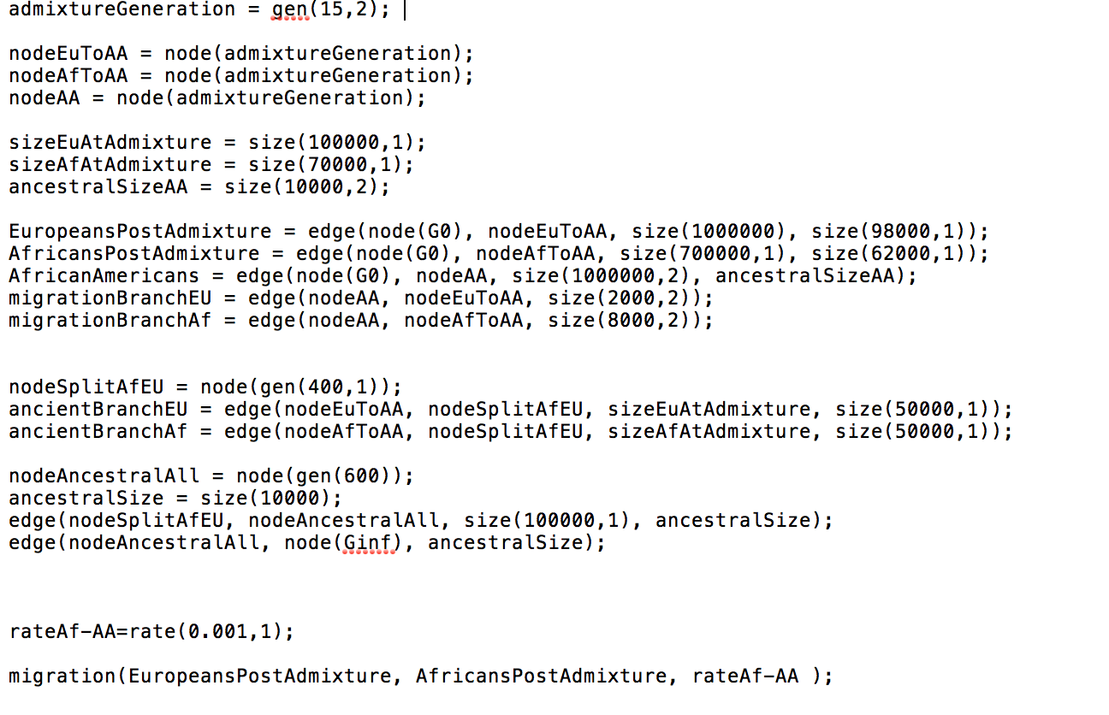
Sample Text File

Slide 5
Need to remember syntax ?
No , need . GUI !

Slide 6
Feature
Read file and produce graph
Create and graph and export it to syntax of simulator
Add node
Add edge between any node to any other node
Migration add/show from GUI
Output in old Genome Simulator format made by University of Michigan

Slide 7
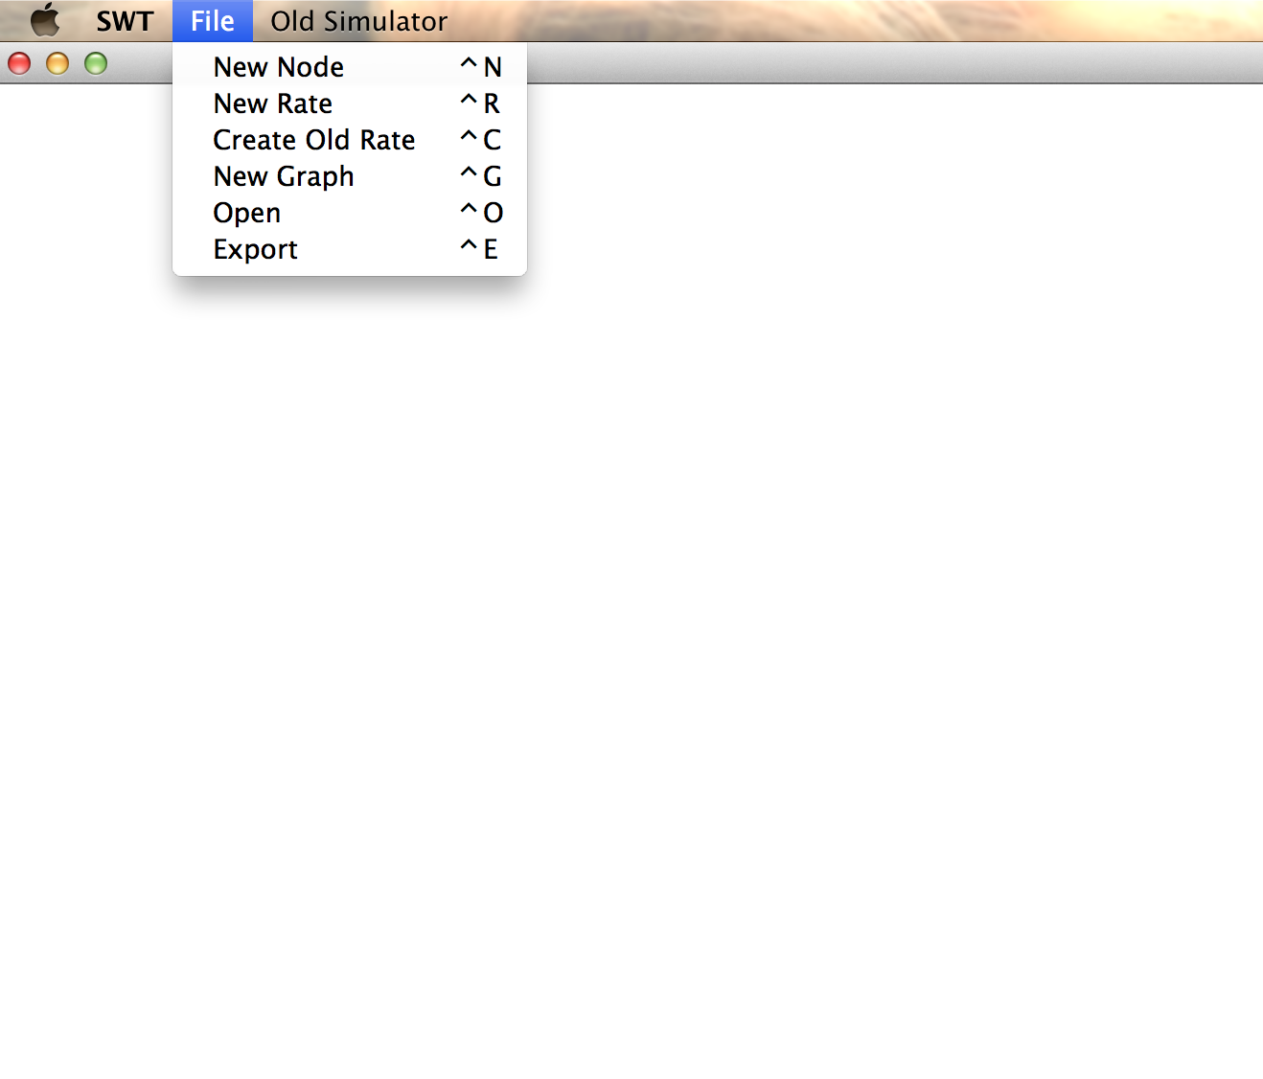
Read file and produce graph
File -> Open

Slide 8
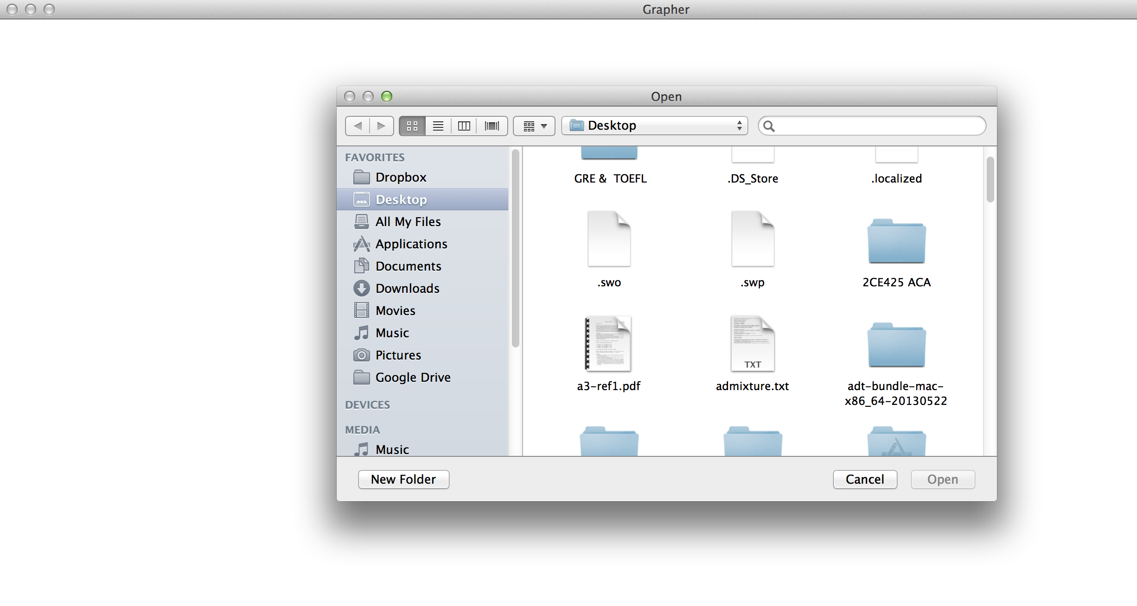
Read file and produce graph

Slide 9
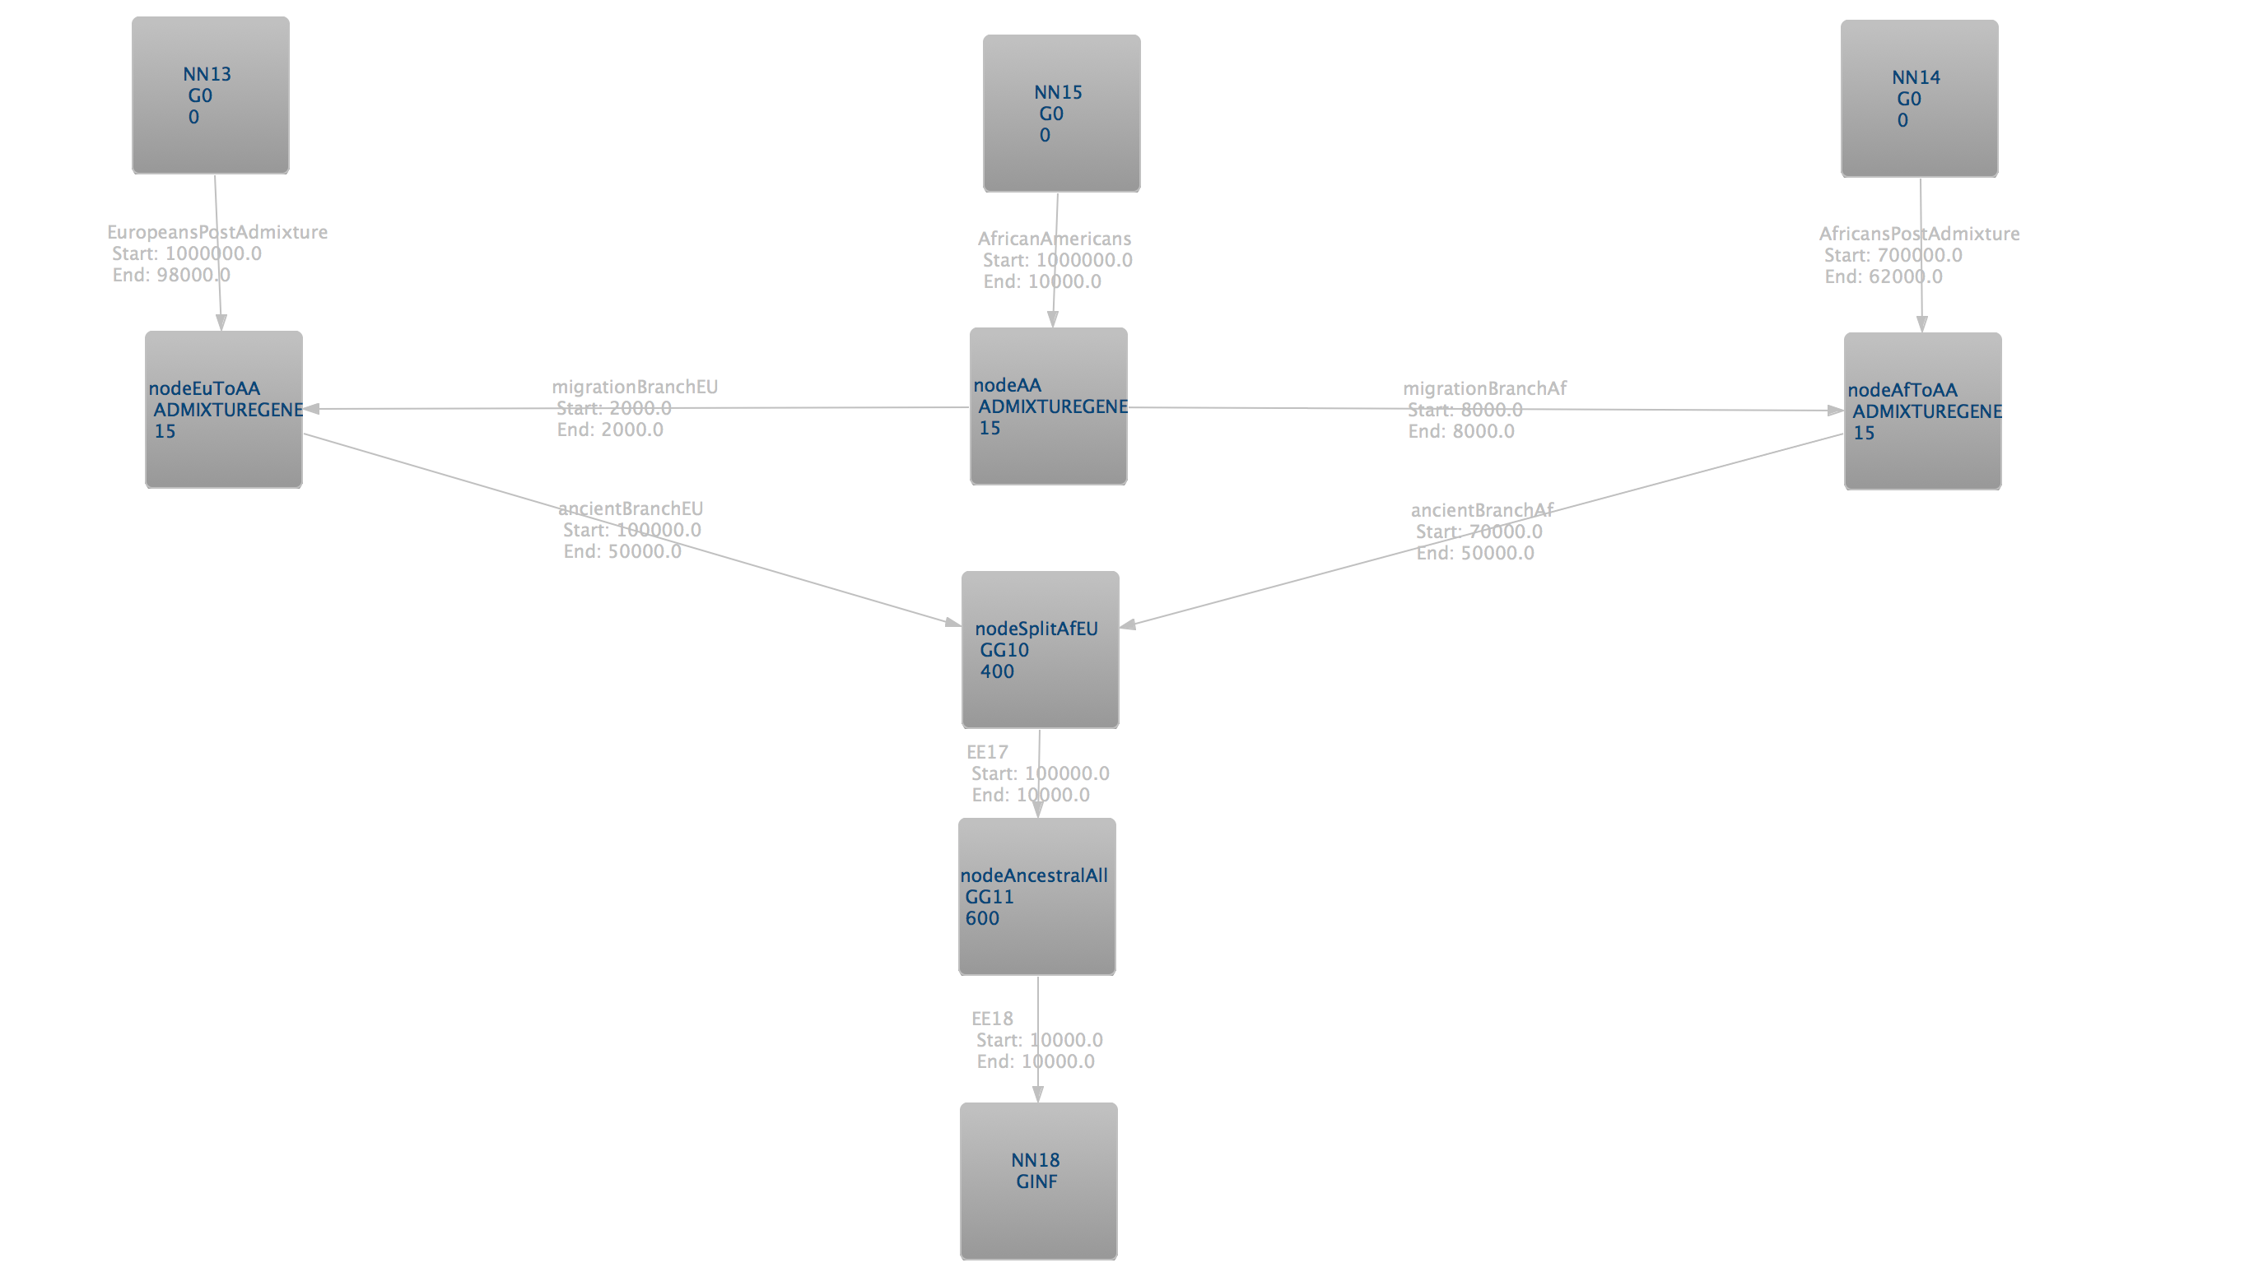
Read file and produce graph

Slide 10
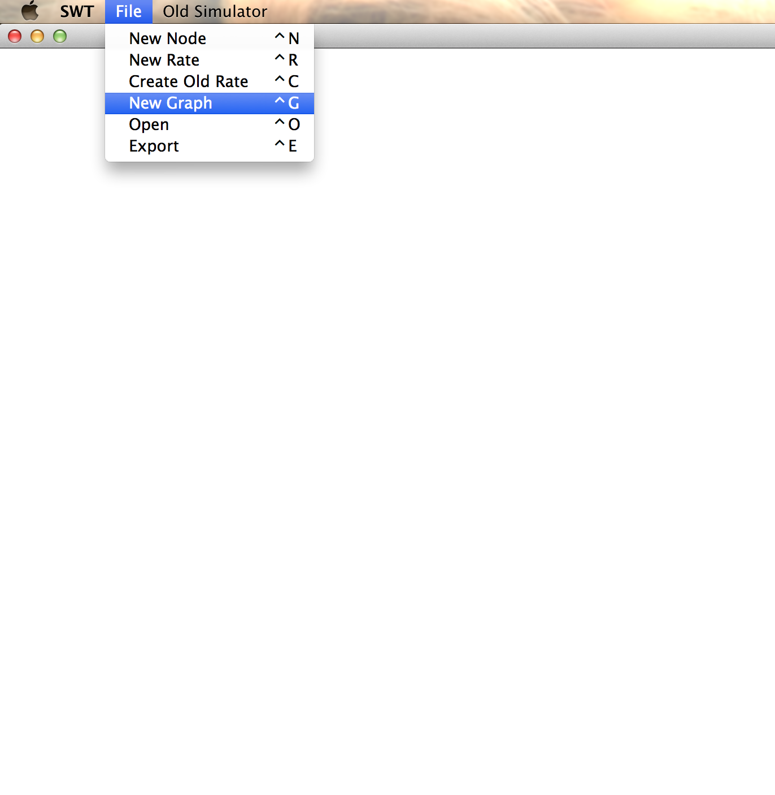
Create and graph and export it to syntax of simulator
File-> New Graph -> (Draw as you want) -> File -> Export

Slide 11

Create and graph and export it to syntax of simulator

Slide 12
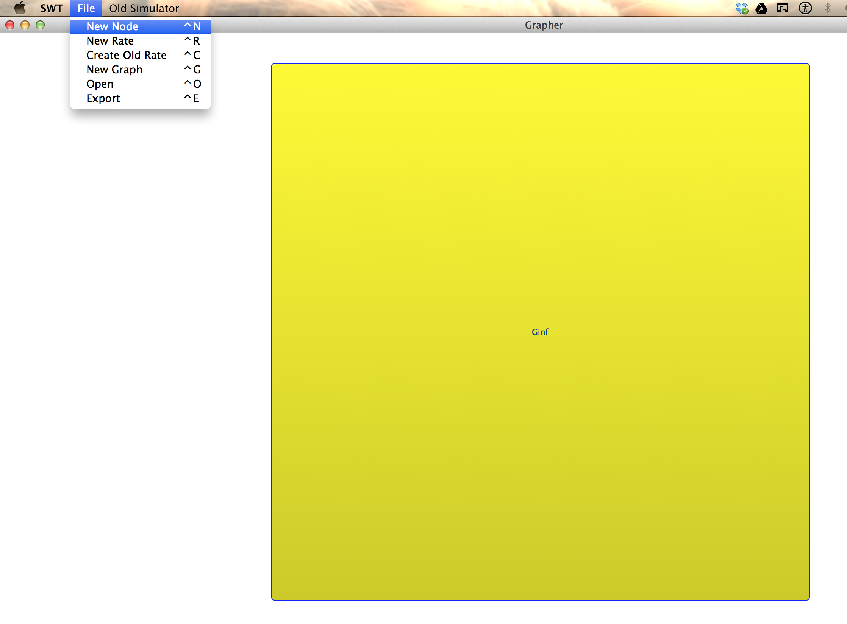
Create and graph and export it to syntax of simulator

Slide 13
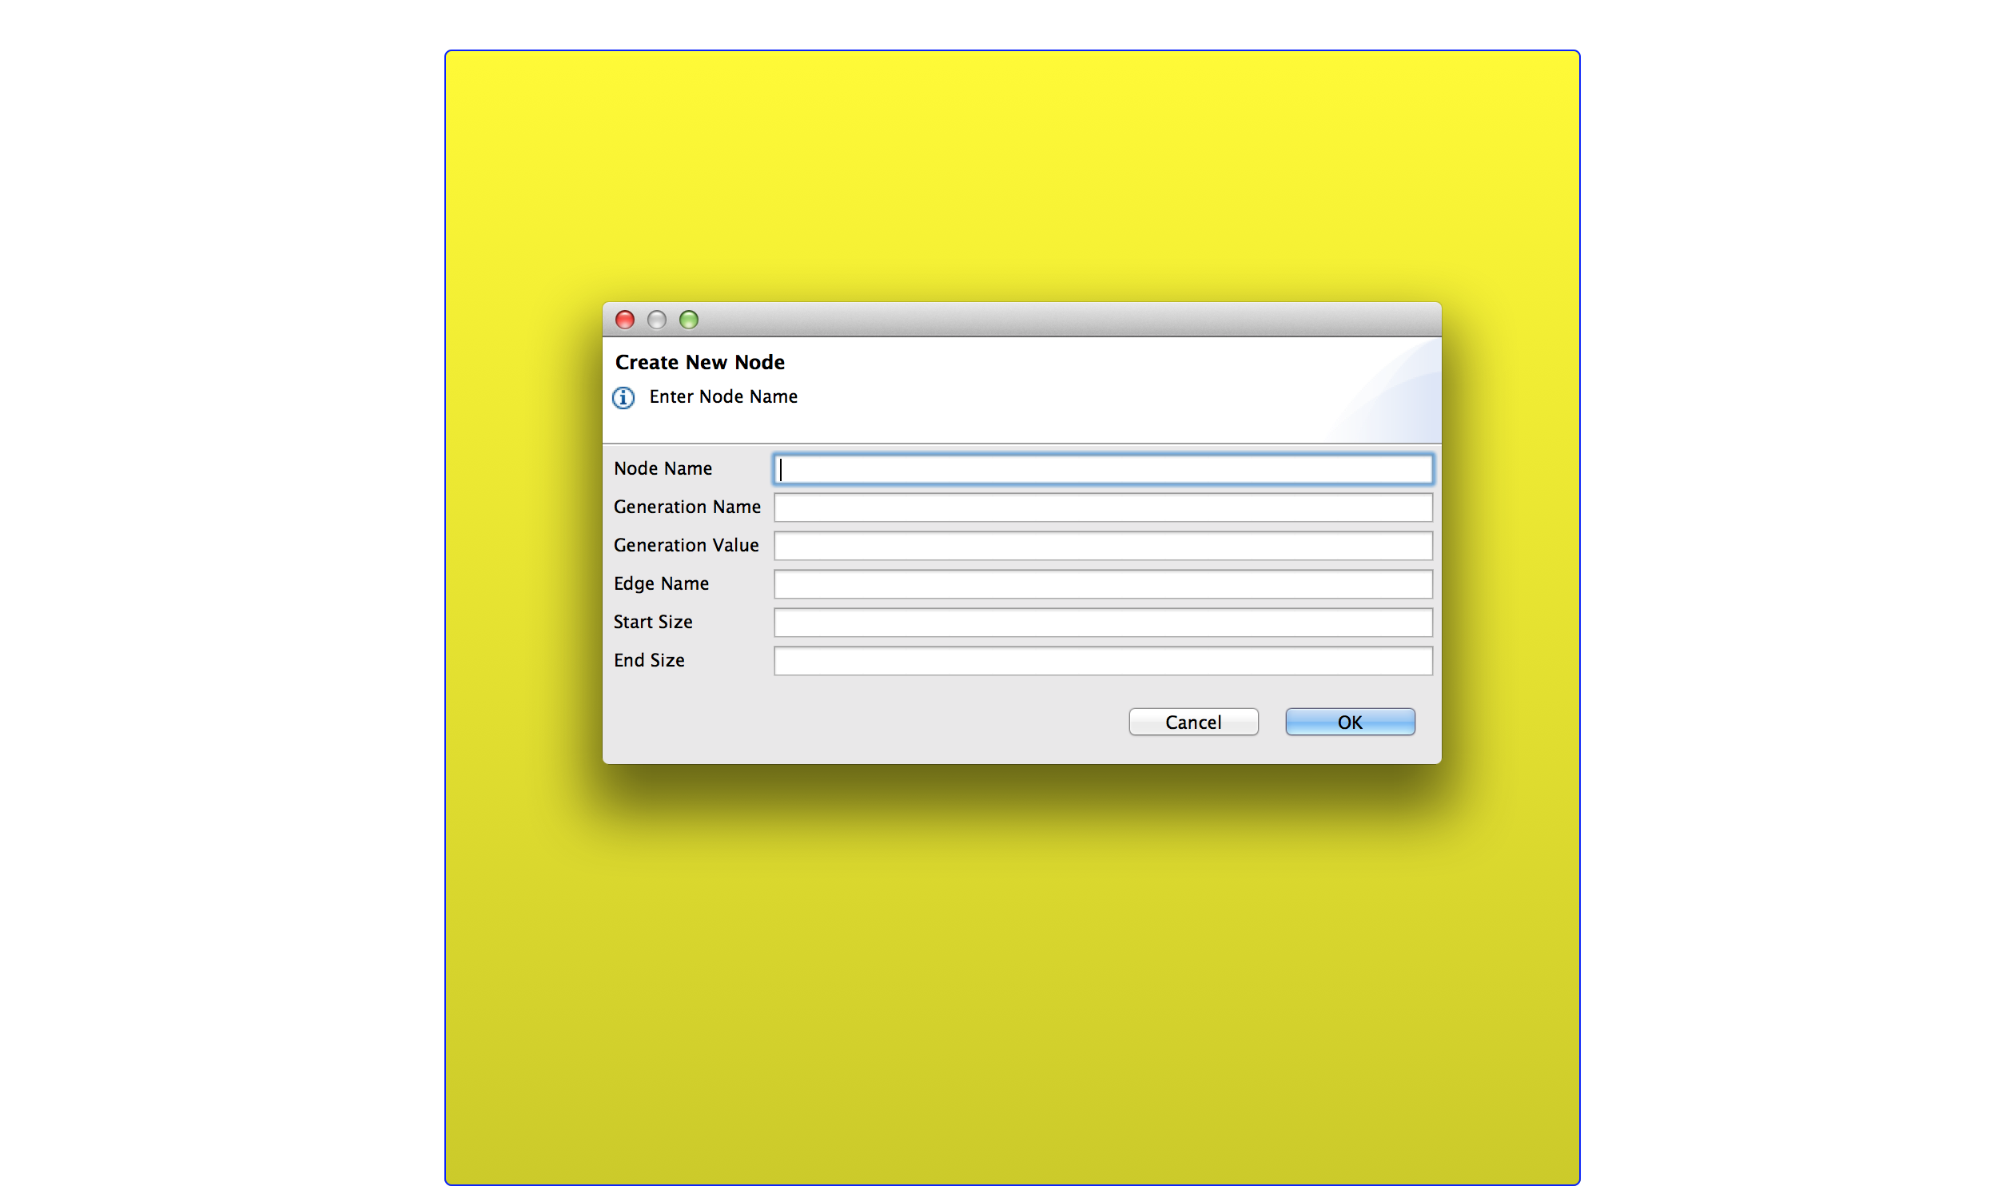
Create and graph and export it to syntax of simulator

Slide 14
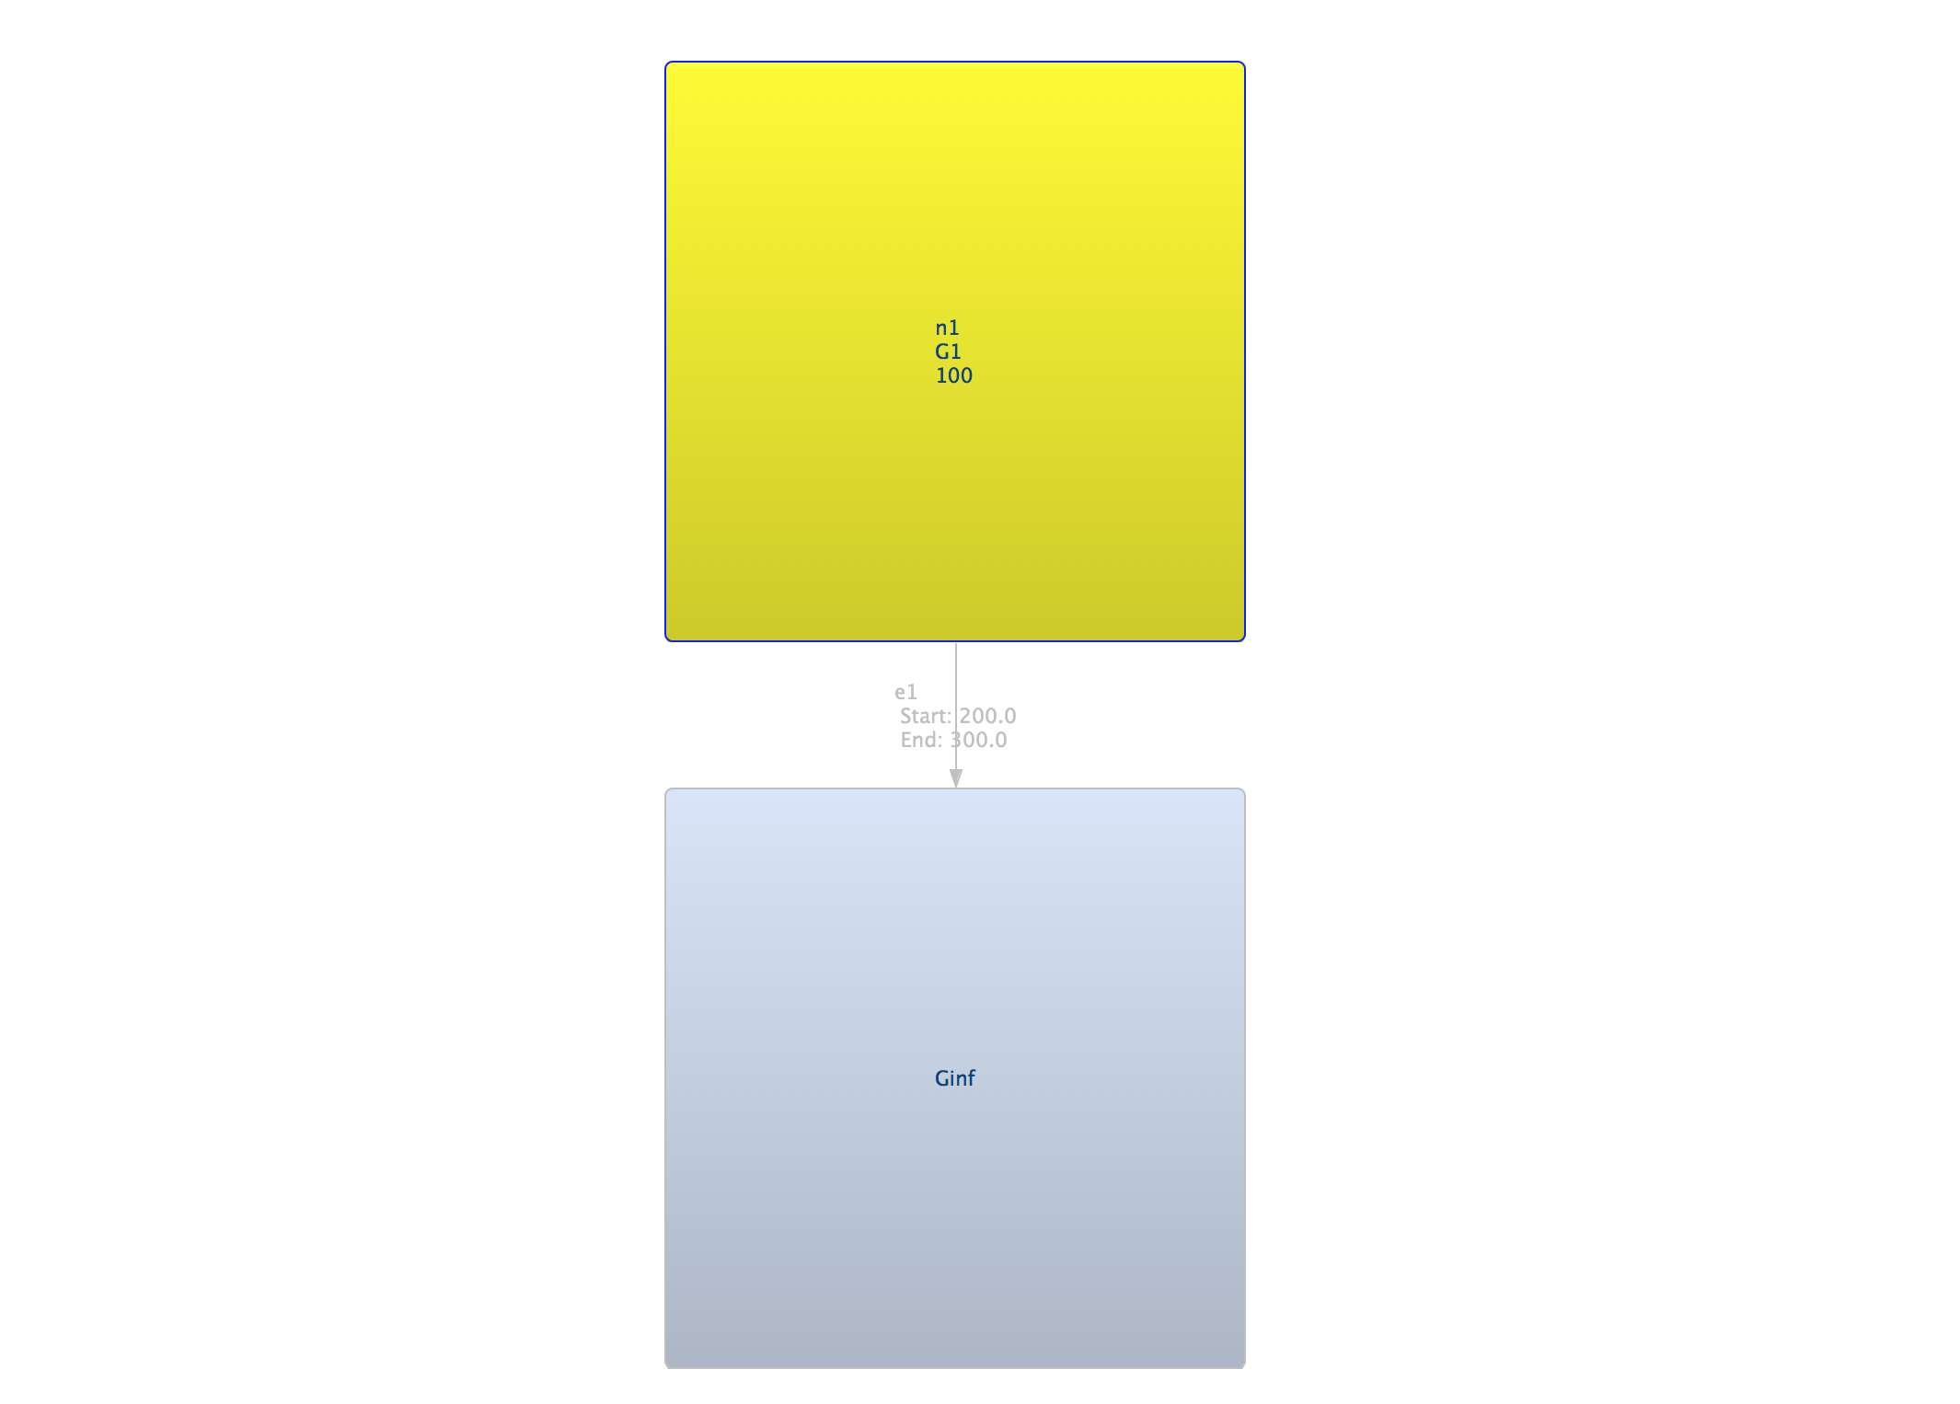
Create and graph and export it to syntax of simulator

Slide 15
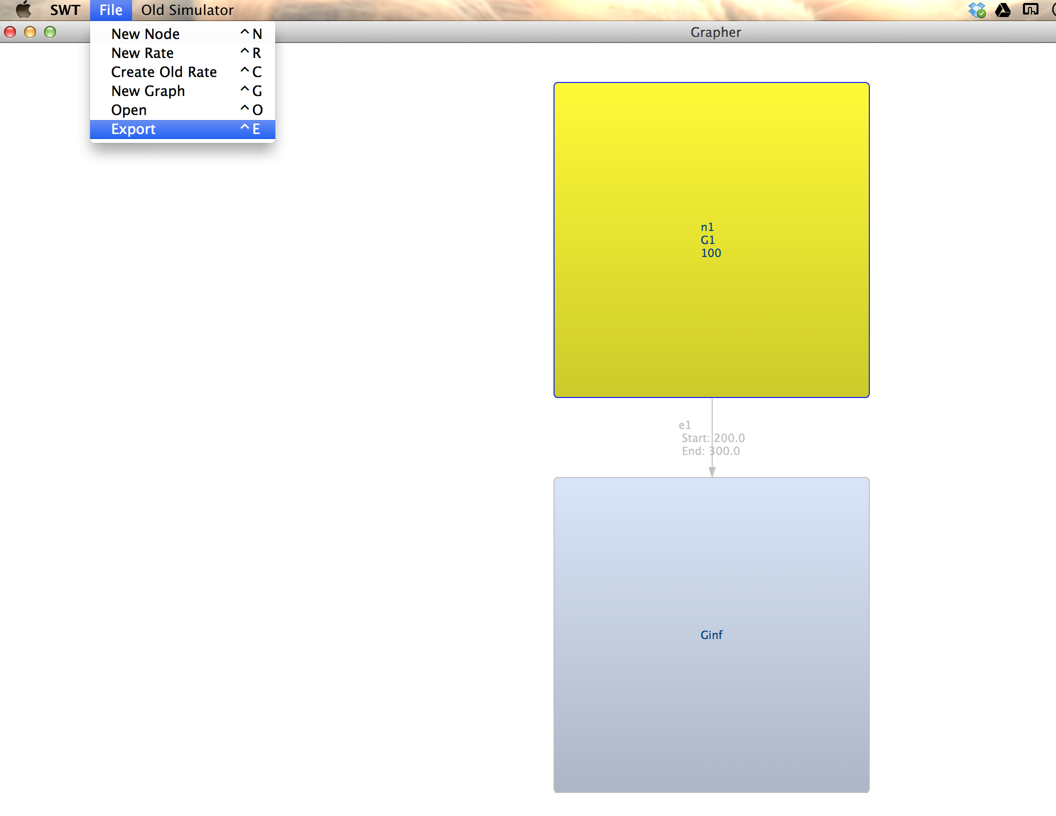
Create and graph and export it to syntax of simulator

Slide 16
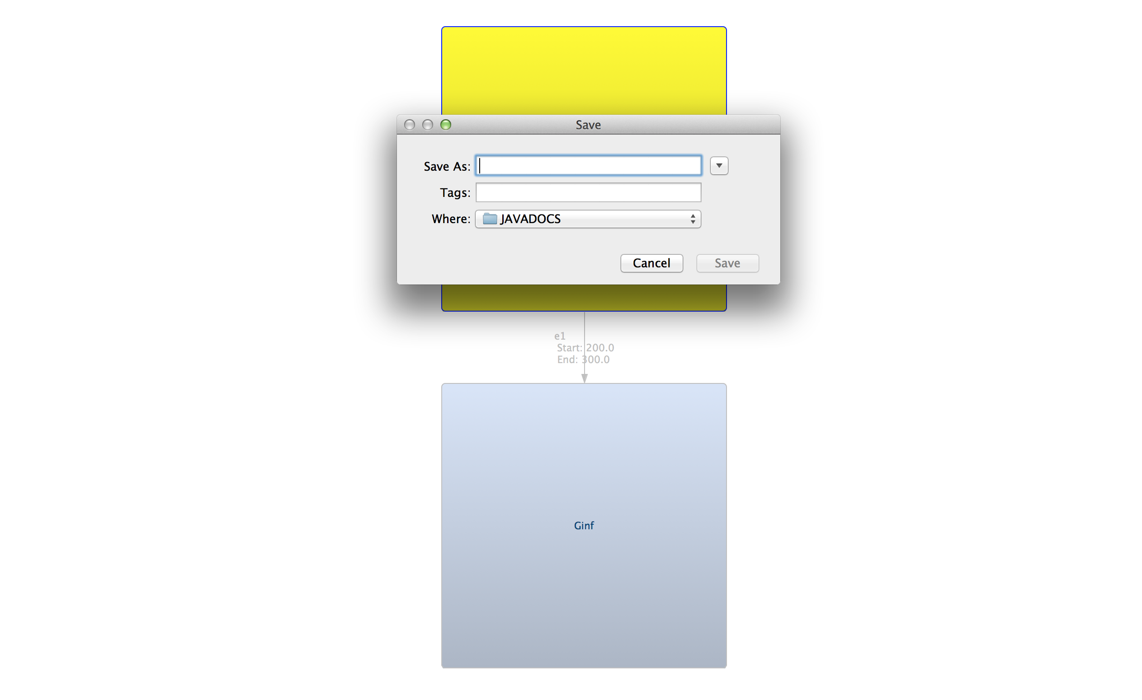
Create and graph and export it to syntax of simulator

Slide 17
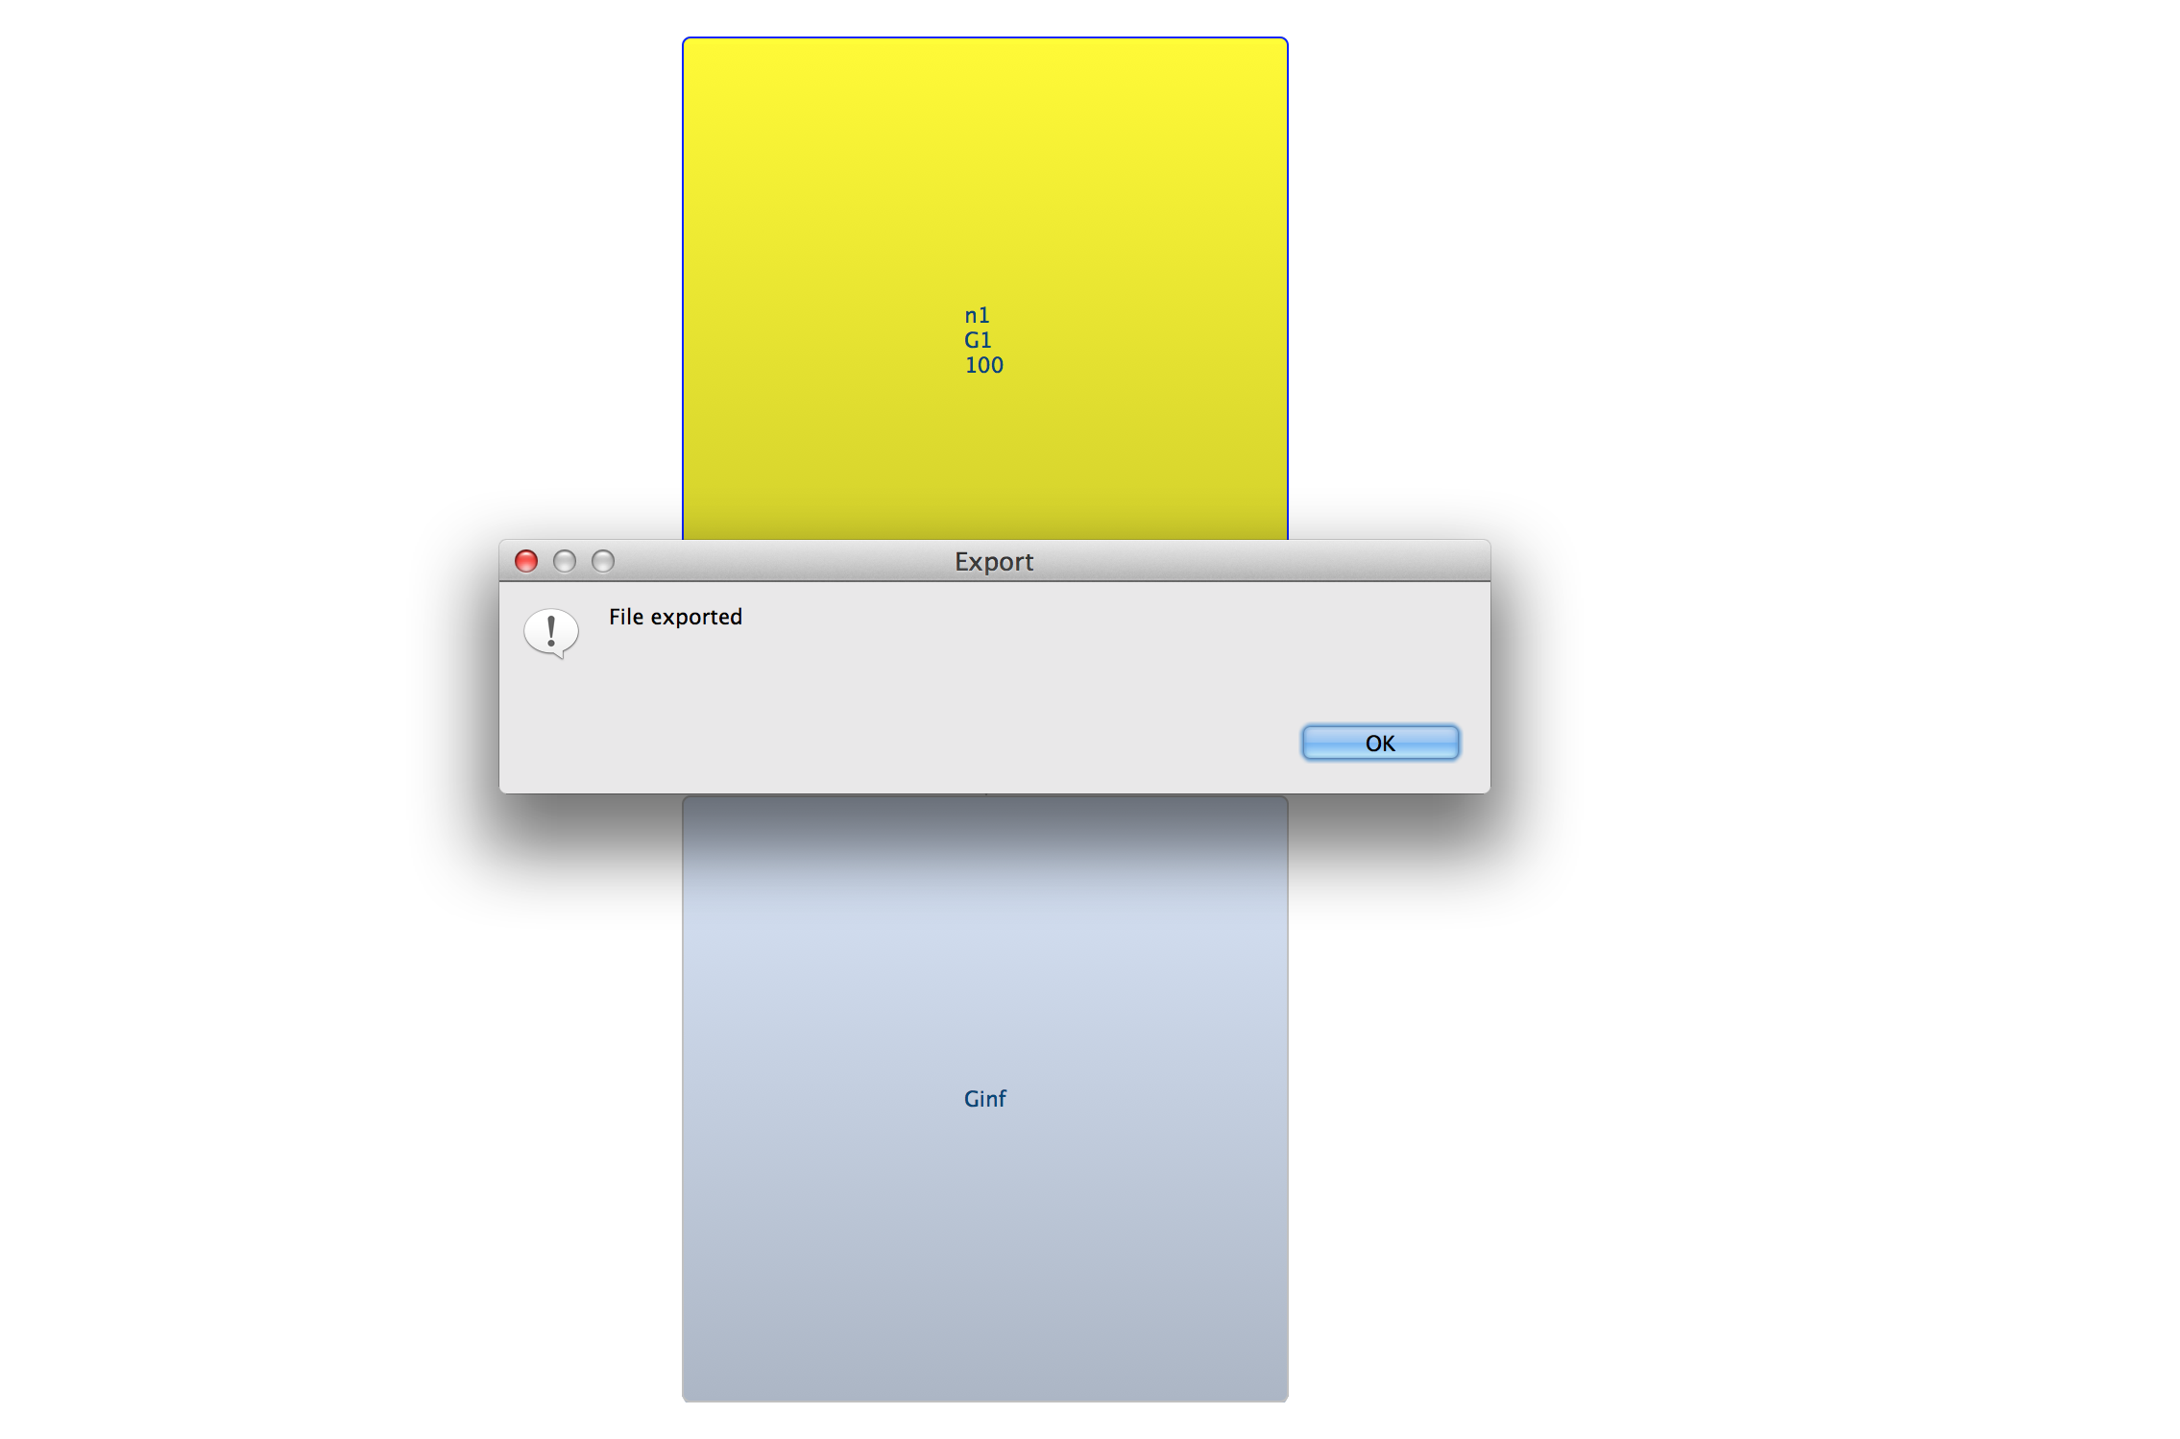
Create and graph and export it to syntax of simulator

Slide 18
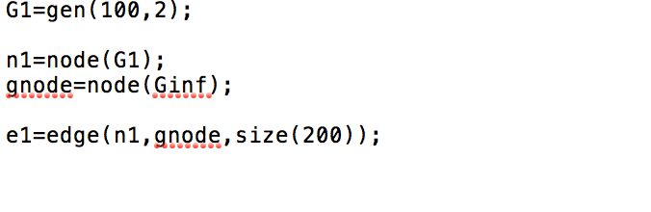
Create and graph and export it to syntax of simulator

Slide 19
Add node
Click on node above which you want to add node and select ‘New Node’ from menu .
To add final node give Generation name as ‘G0’ and Generation Value as ‘0’
Each node in generation just below G0 generation , should have individual nodes in G0 generation having generation name as G0 and generation value as 0.
To add node above given node : File -> New Node

Slide 20
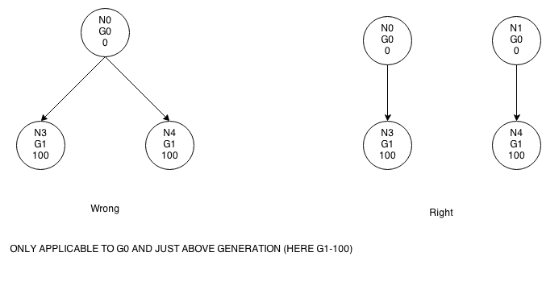
Add node

Slide 21
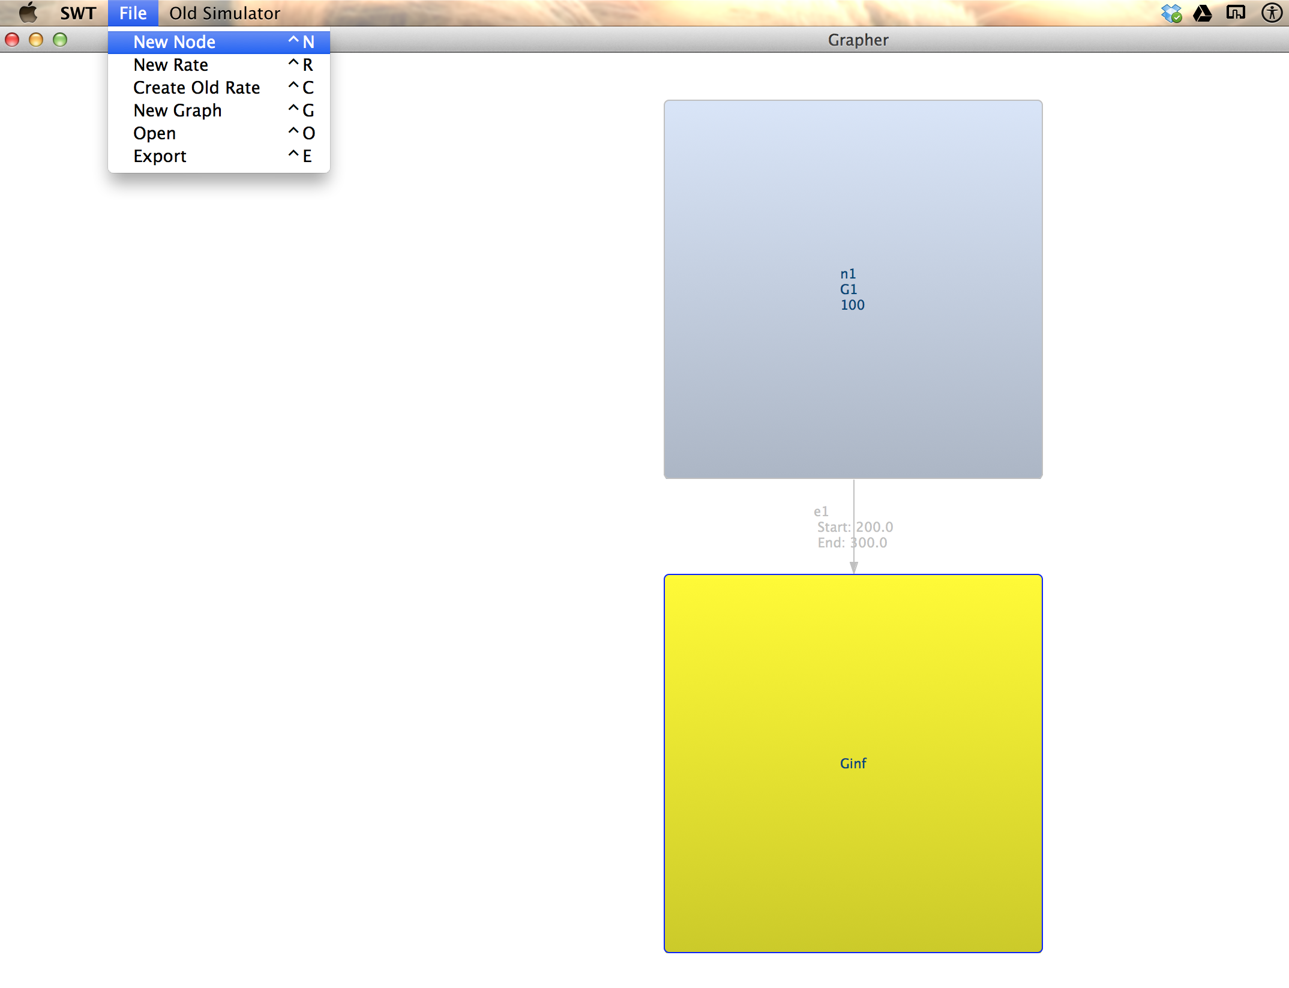
Add node

Slide 22
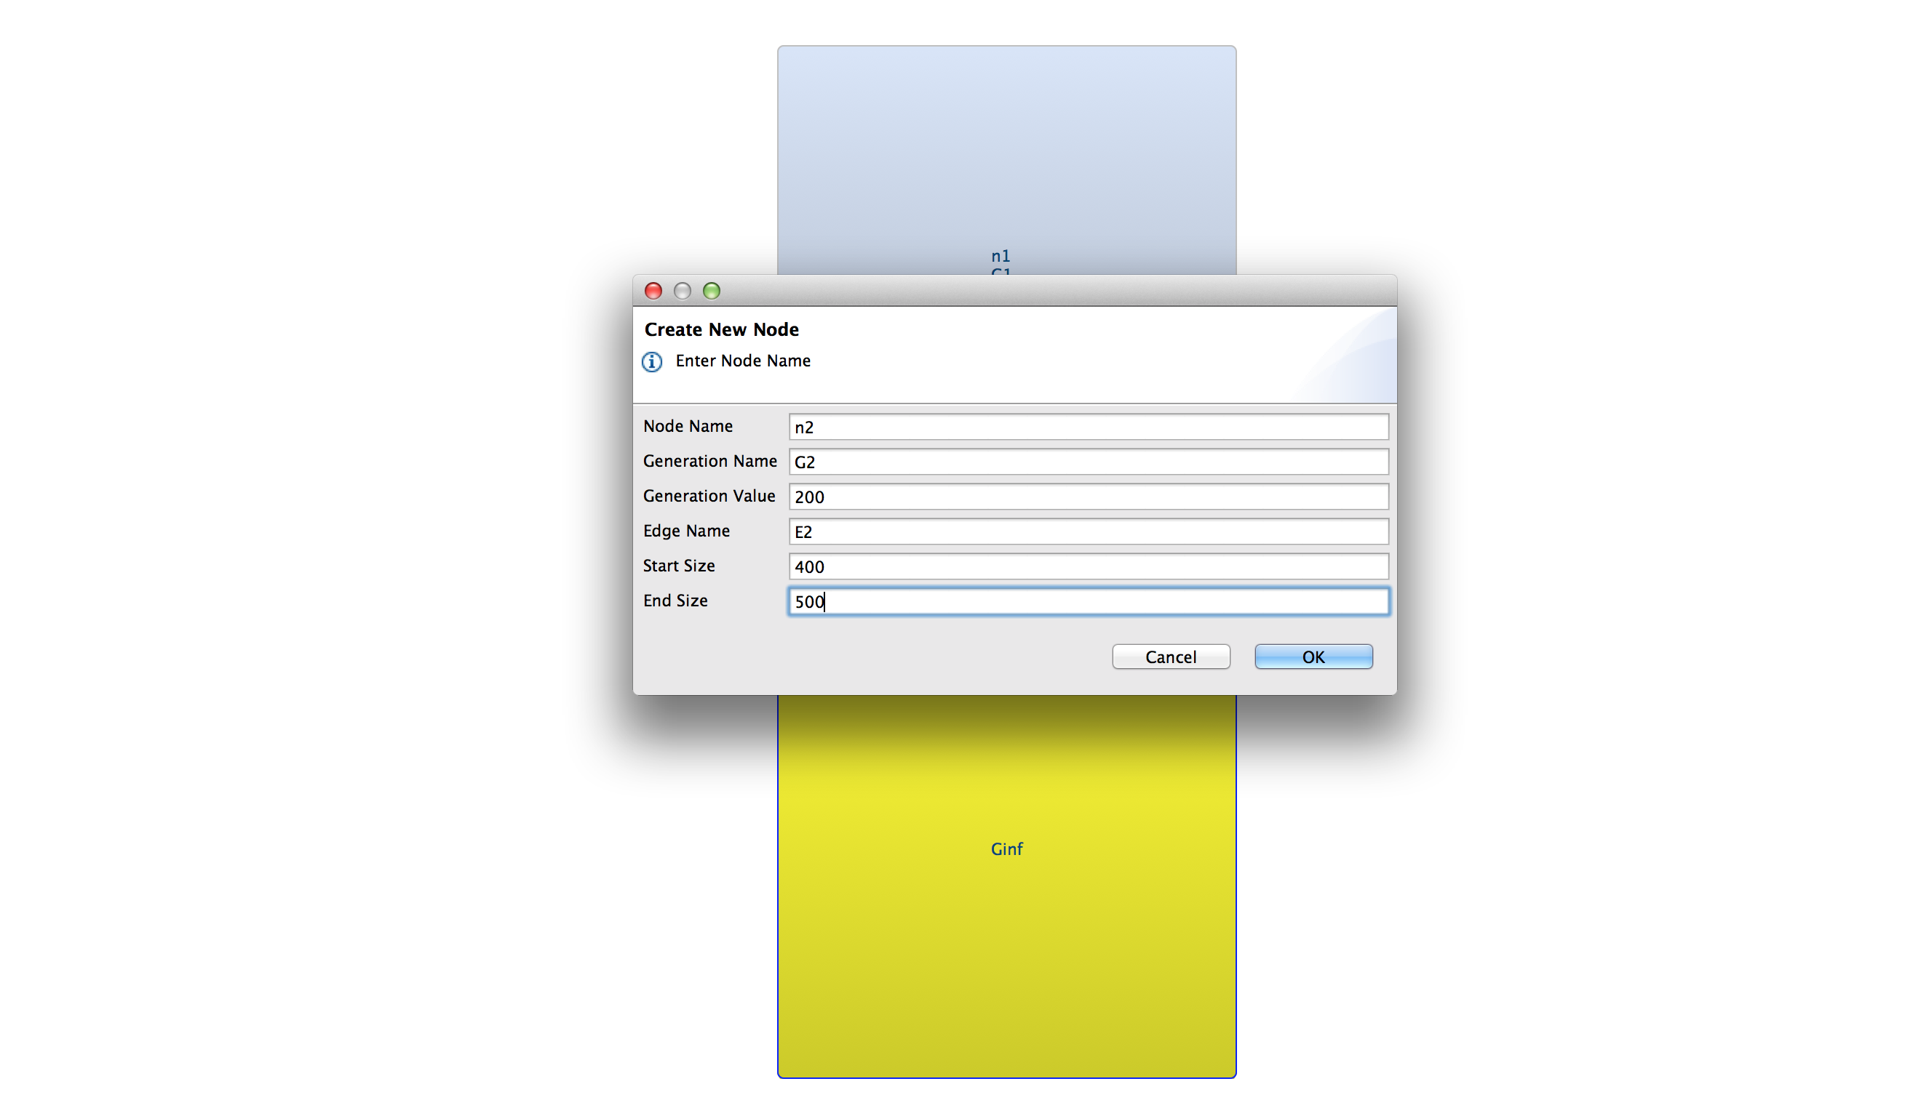
Add node

Slide 23
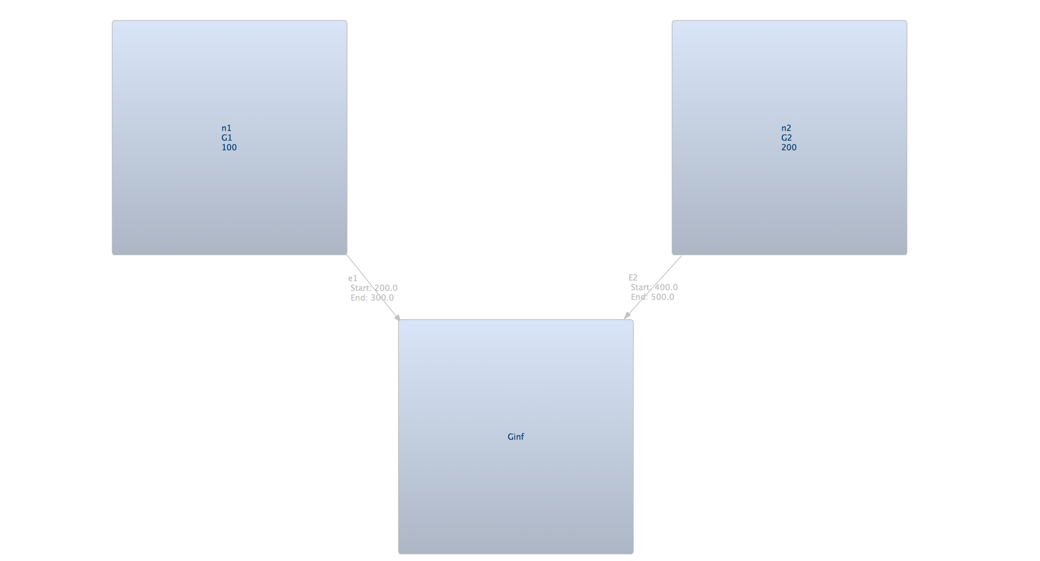
Add node

Slide 24
Add edge between any node to any other node
Click on first node from which you want the edge to start .
Press CTRL
Click on second node at which you want to end edge .

Slide 25
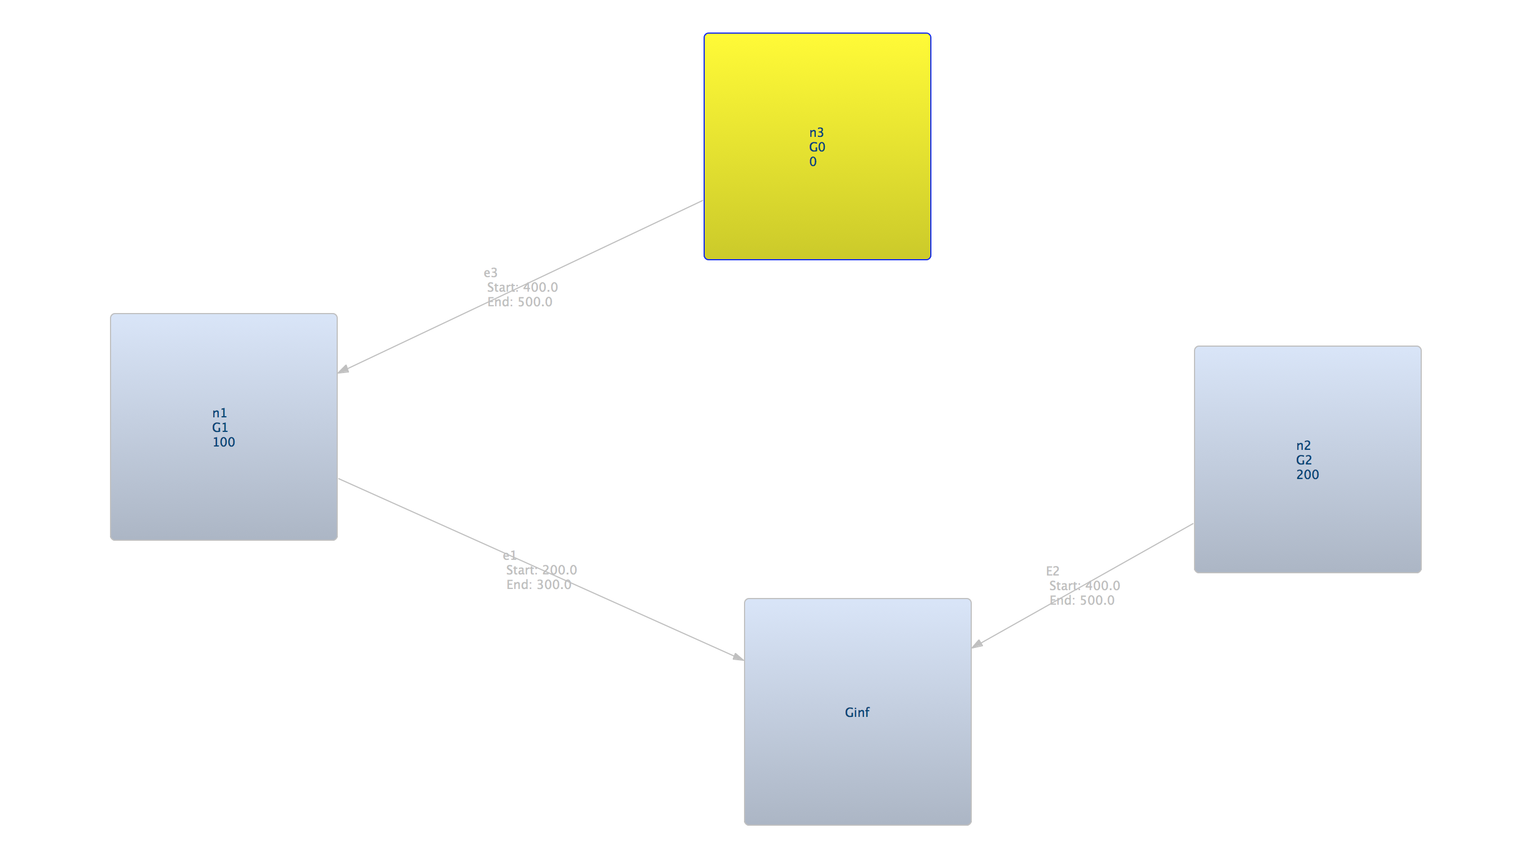
Add edge between any node to any other node

Slide 26
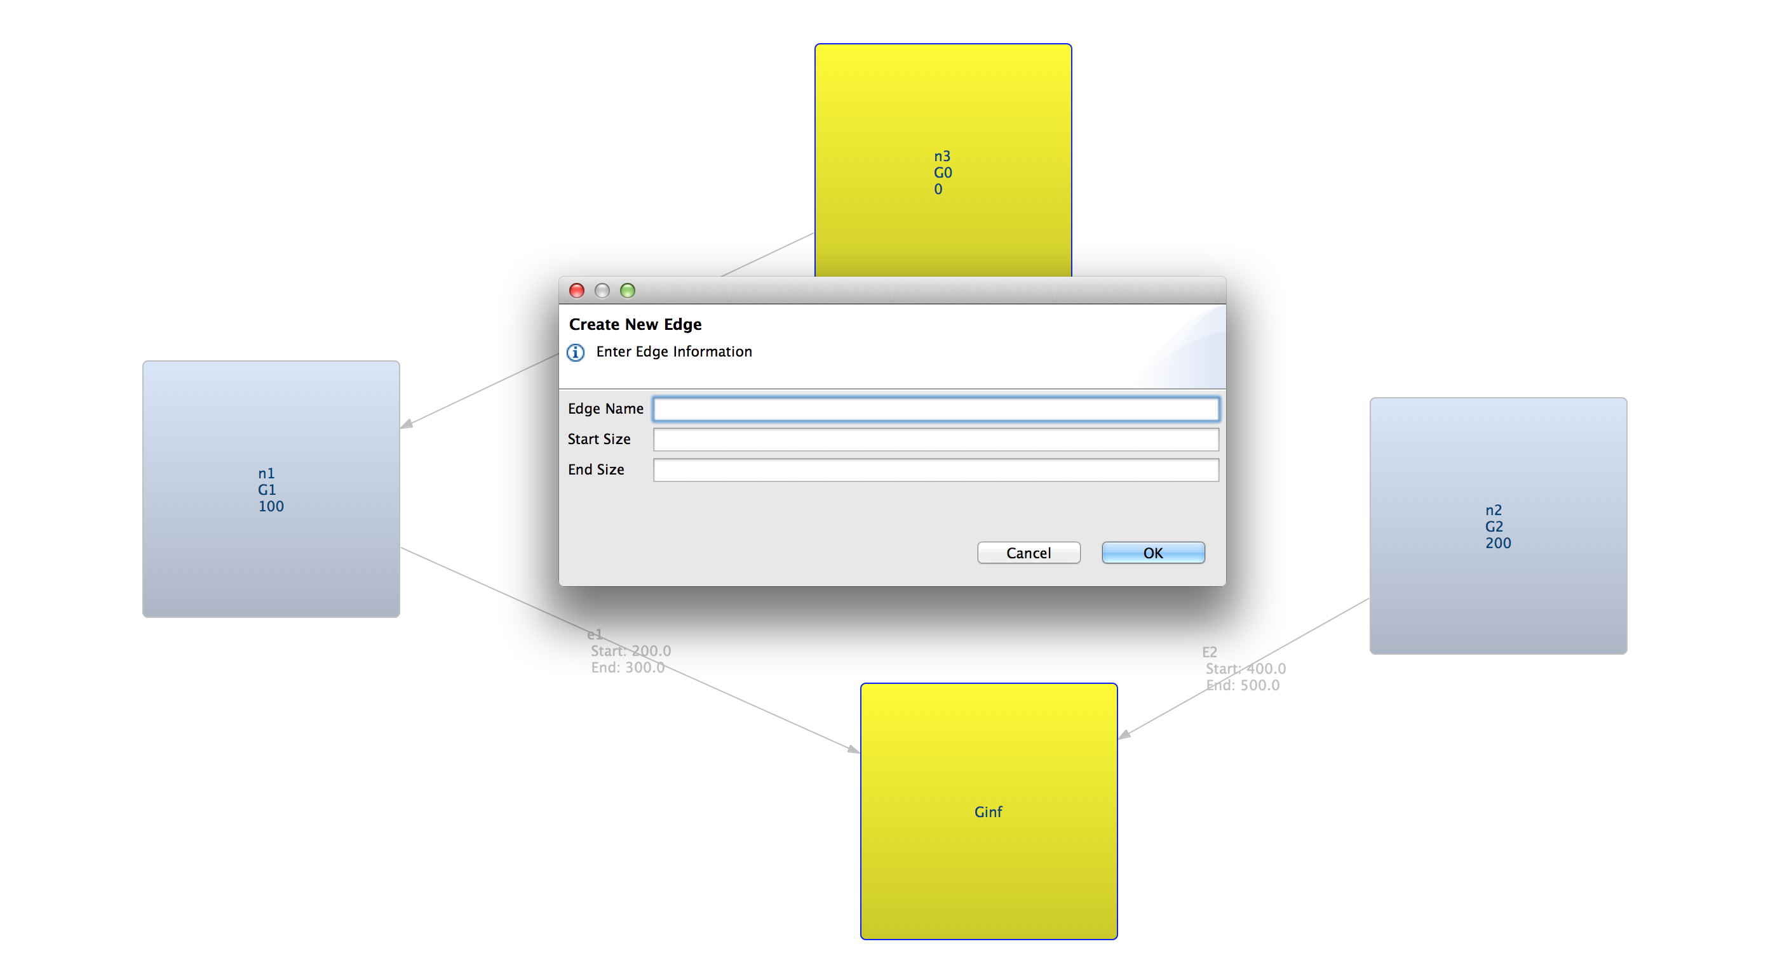
Add edge between any node to any other node

Slide 27
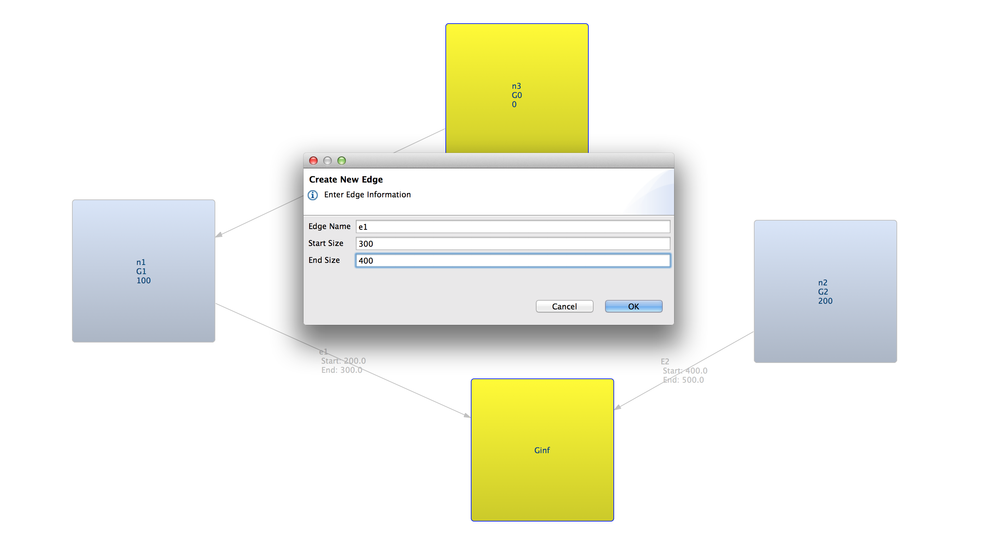
Add edge between any node to any other node

Slide 28
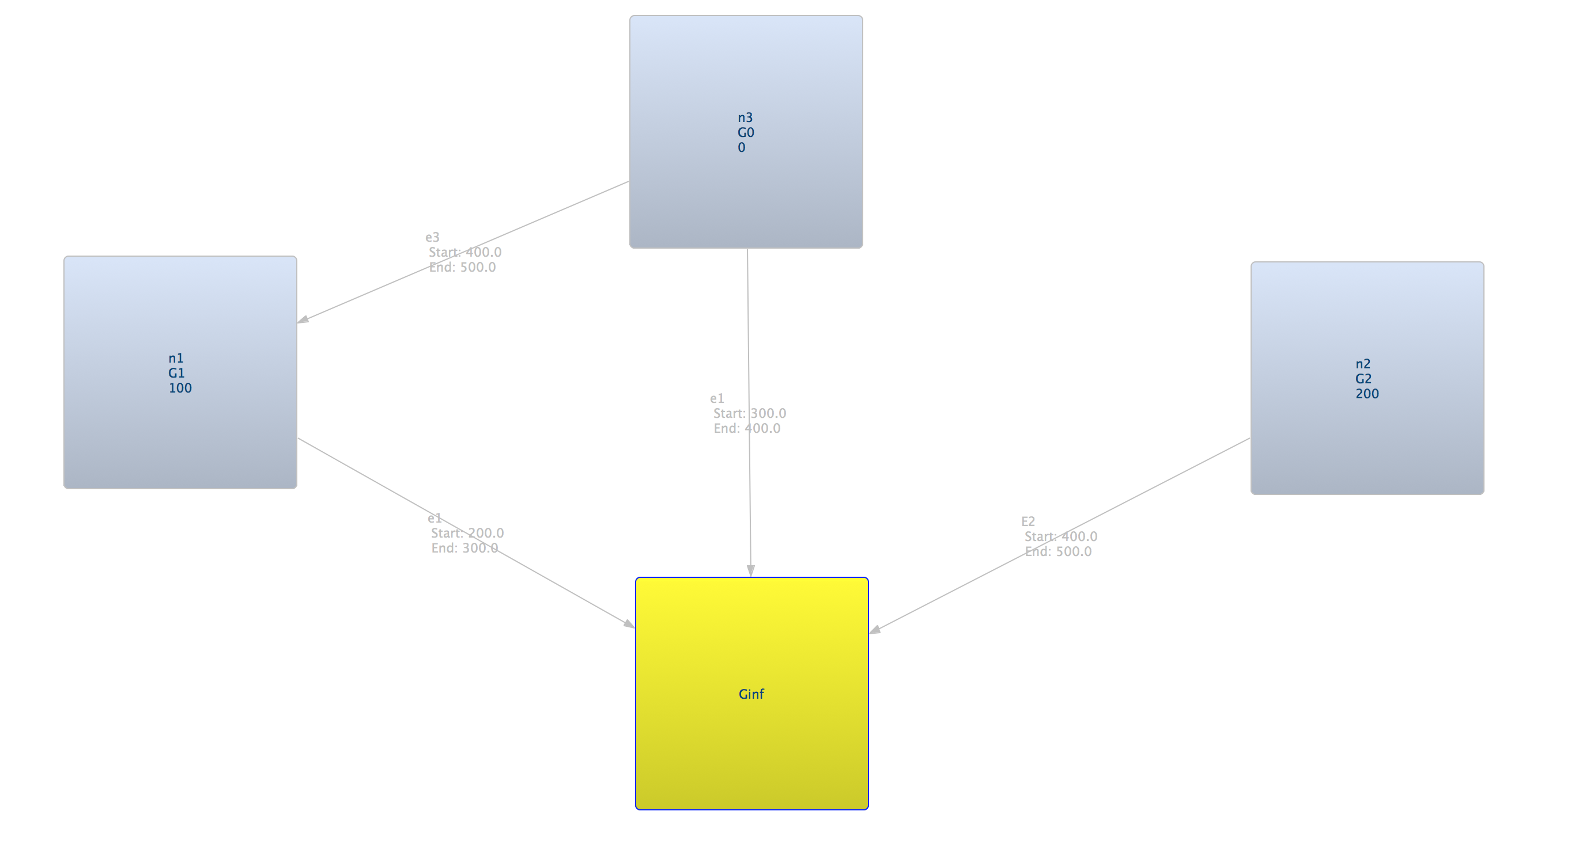
Add edge between any node to any other node

Slide 29
Migration add/show from GUI
MIGRATION ADDED BETWEEN NODES OF SAME GENERATION
First enter Rate.
Click on the first edge between which you want to add migration .
Hold CTRL
Click on second edge on which you want to add migration .

Slide 30
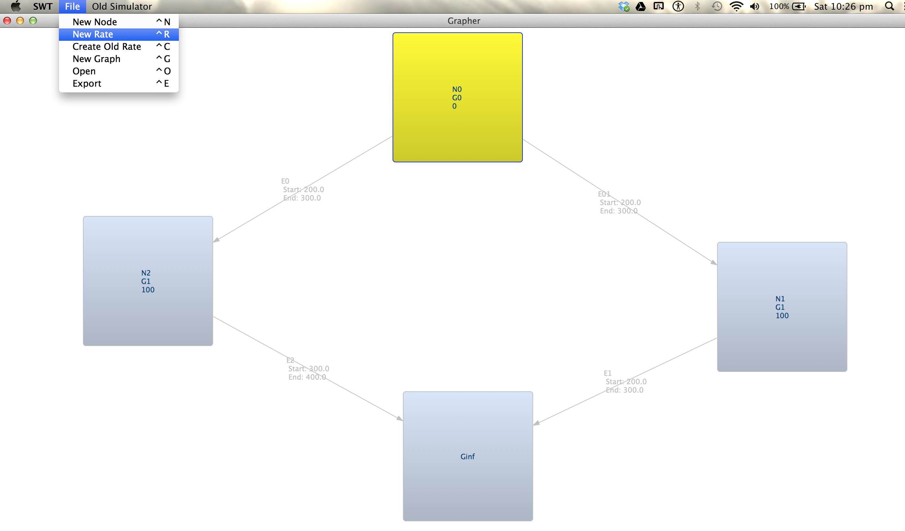
Migration add/show from GUI

Slide 31
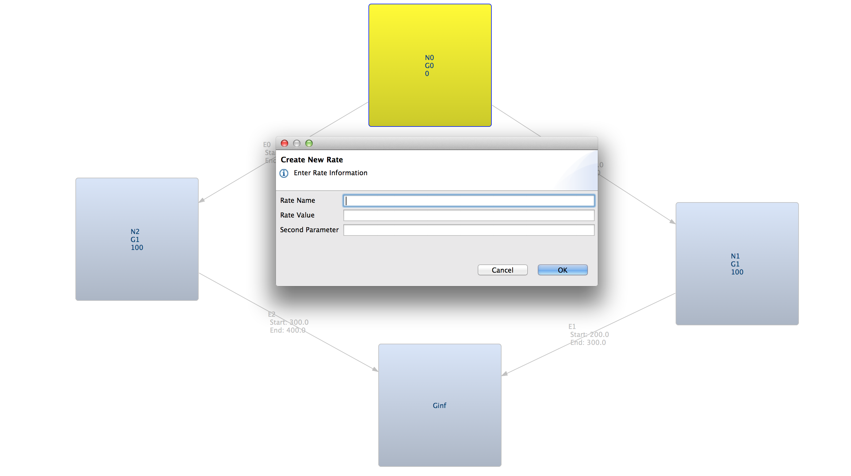
Migration add/show from GUI

Slide 32
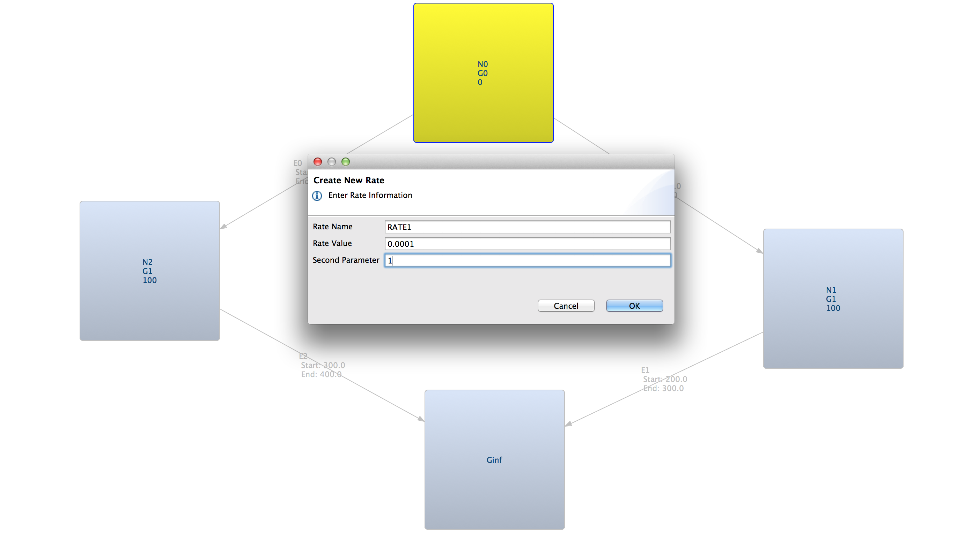
Migration add/show from GUI

Slide 33
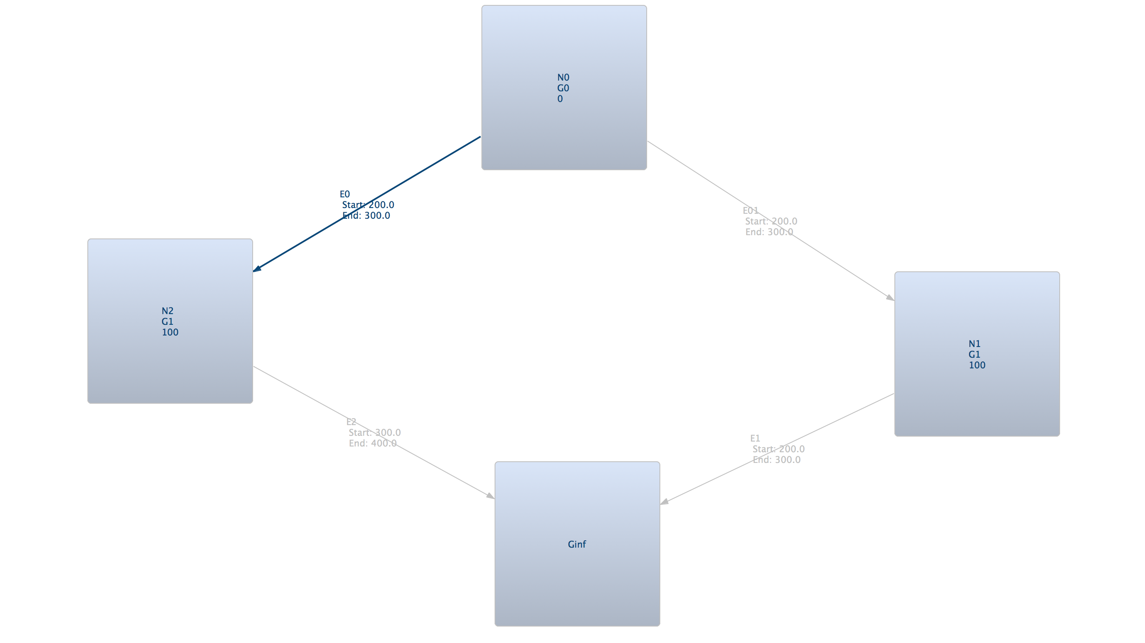
Migration add/show from GUI

Slide 34
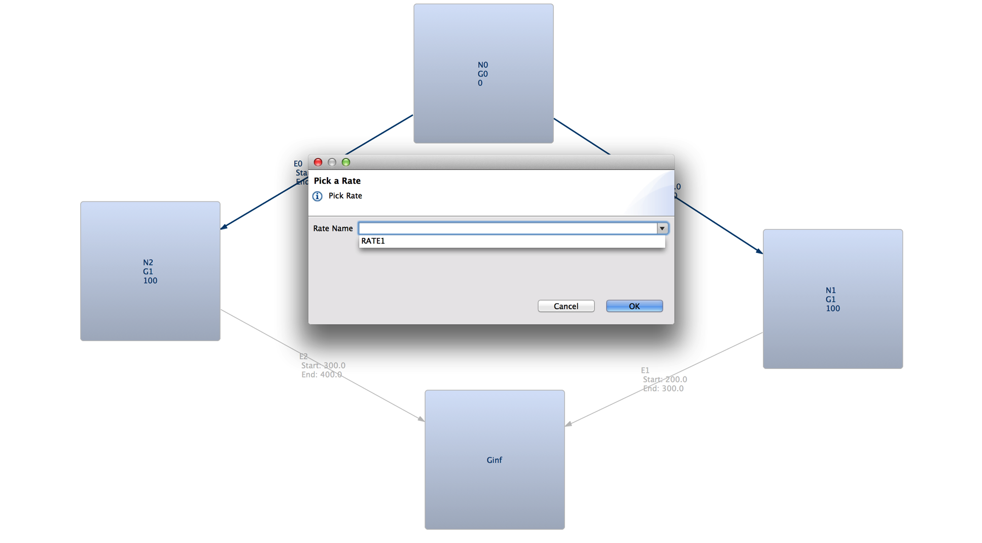
Migration add/show from GUI

Slide 35
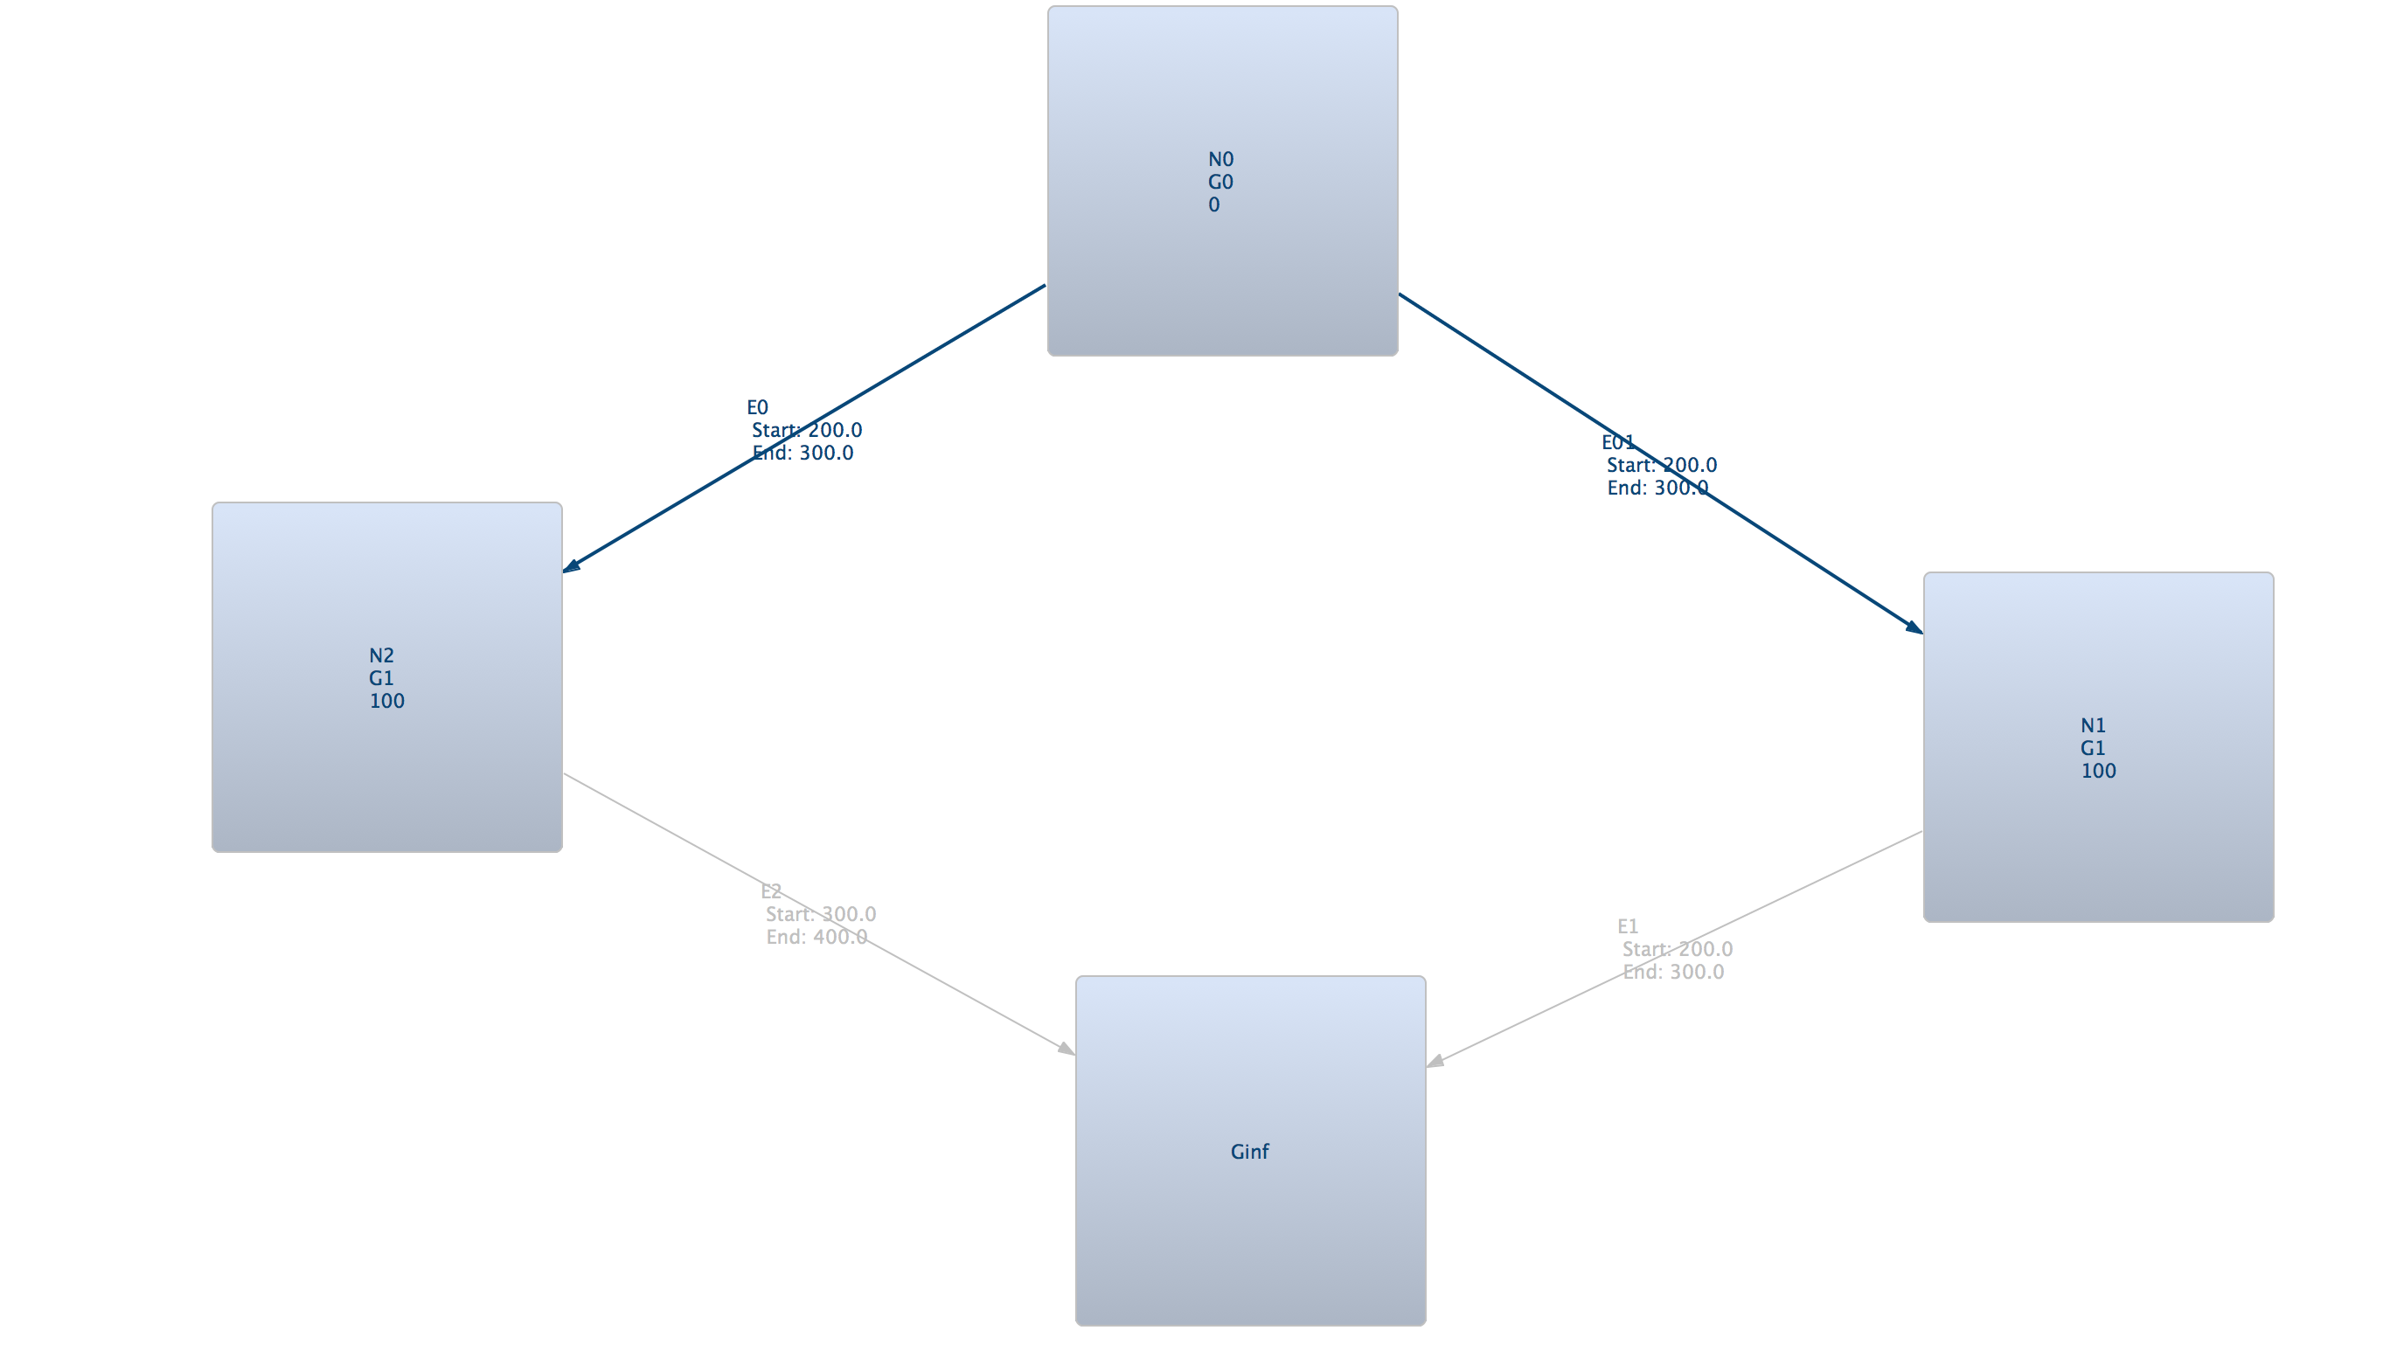
Migration add/show from GUI

Slide 36
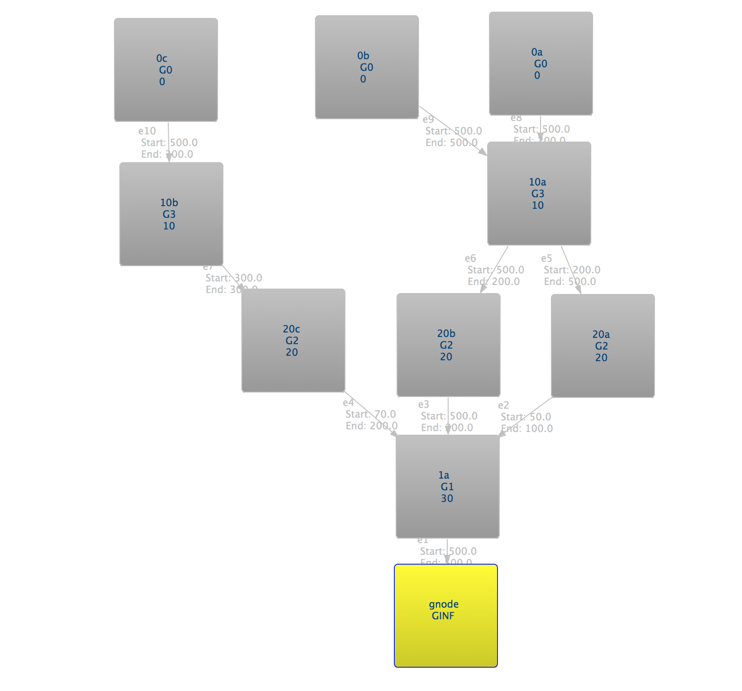
Output in Old Genome Simulator format
Source: http://www.sph.umich.edu/csg/liang/genome/

Slide 37
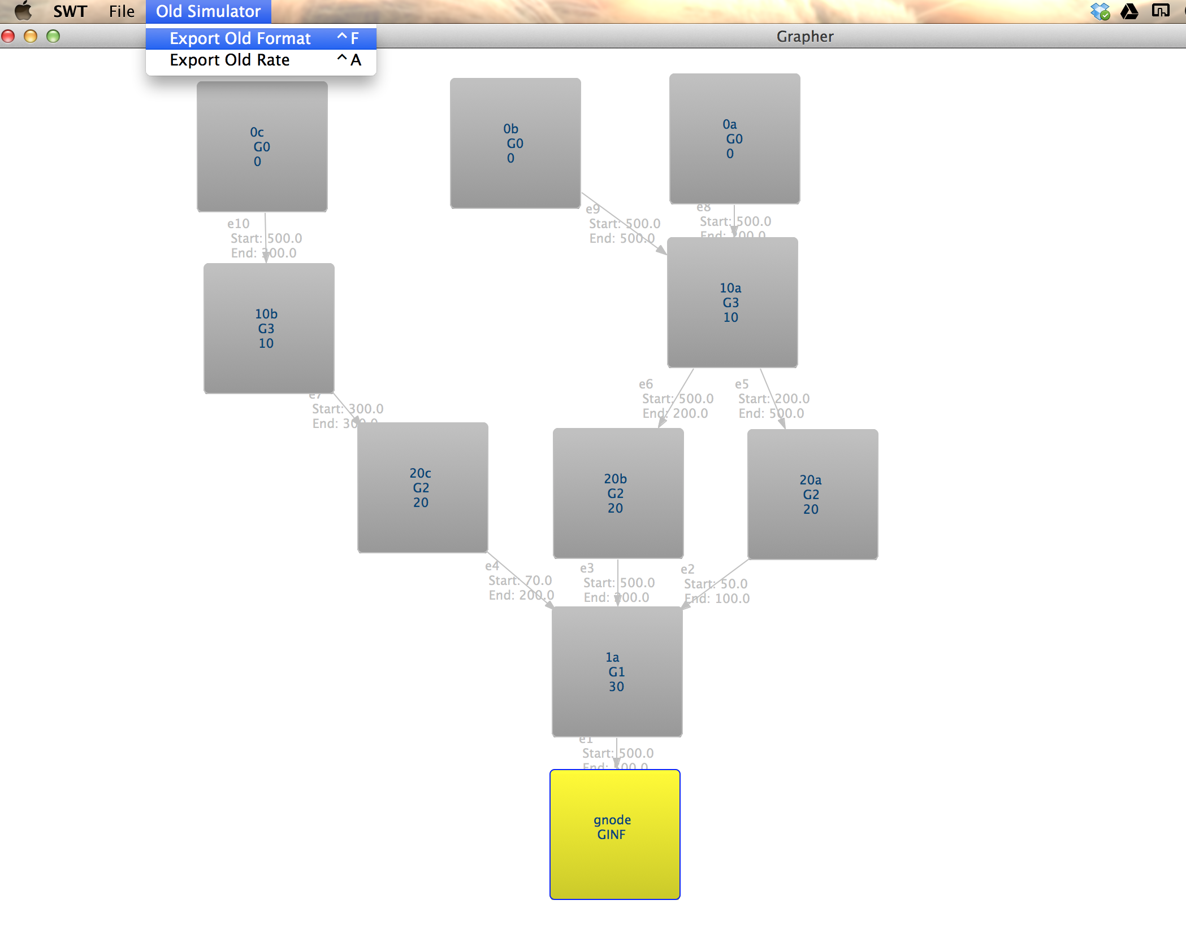
Output in Old Genome Simulator format

Slide 38
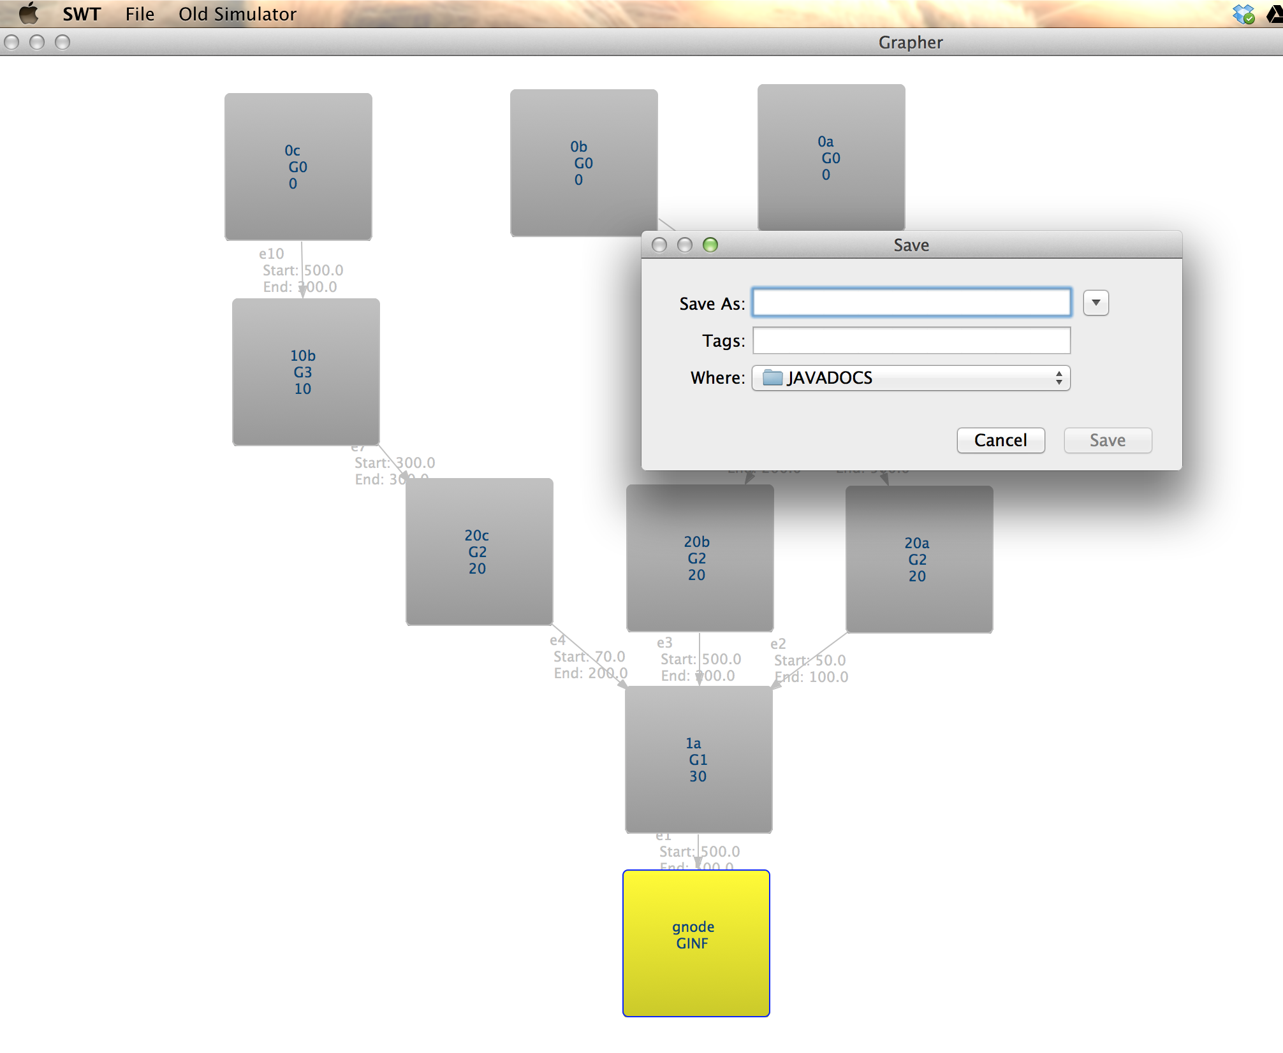
Output in Old Genome Simulator format

Slide 39
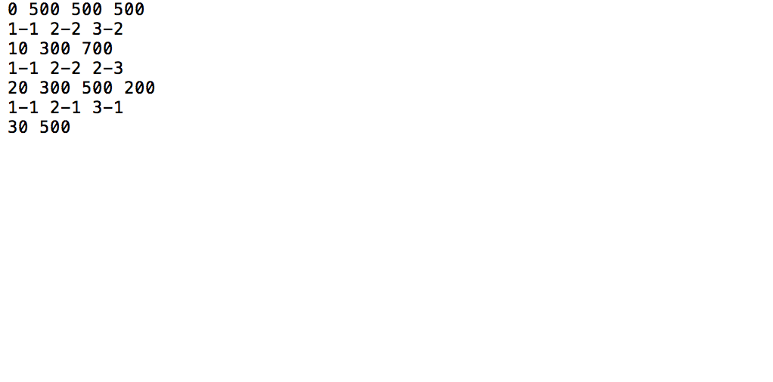
Output in Old Genome Simulator format

Slide 40
Thank You
For constant guidance given by
Dr. Itsik Peer . http://www.cs.columbia.edu/~itsik/home.html
Dr. Pier Palamara. http://www.cs.columbia.edu/~pier/

